Slide 1


MEDITECH Expanse Documents
Web Based EHR
MUST be viewed as a Slide Show

Slide 2

Contents
Navigating Document Screen
Navigating a Document
Section
Review of Systems
Typicals
PMFSH
Meds
Exam
Results
VTE/CVA
A&P
Slide 3
Slide 7
Slide 14
Slide 18
Slide 22
Slide 28
Slide 38
Slide 44
Slide 46
Slide 50
Slide 52

Slide 3
Navigating documentation screen

Slide 4
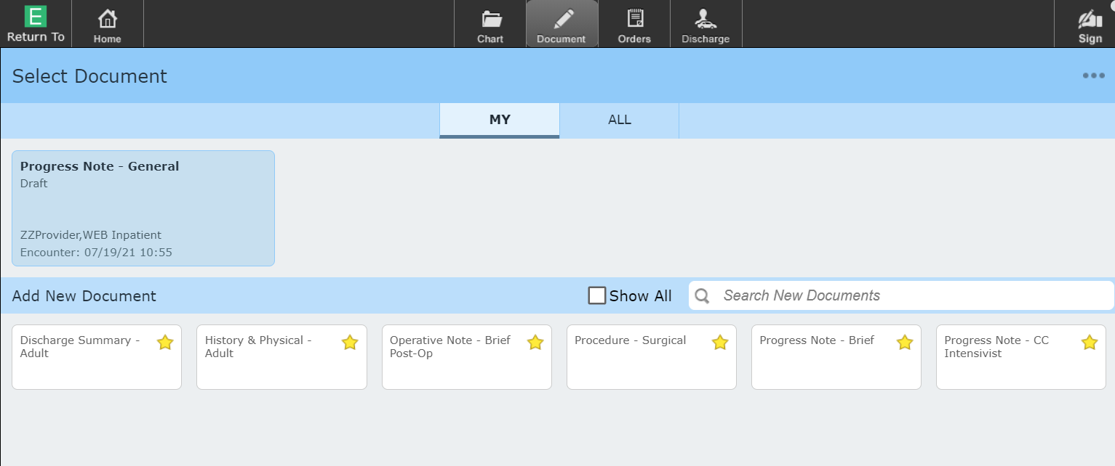
Document Navigating Document Screen
Document Screen
MY/ALL – Defaults to “MY” and opening a document under “ALL” can be problematic
All your draft/pending documents display – Click to open

Slide 5
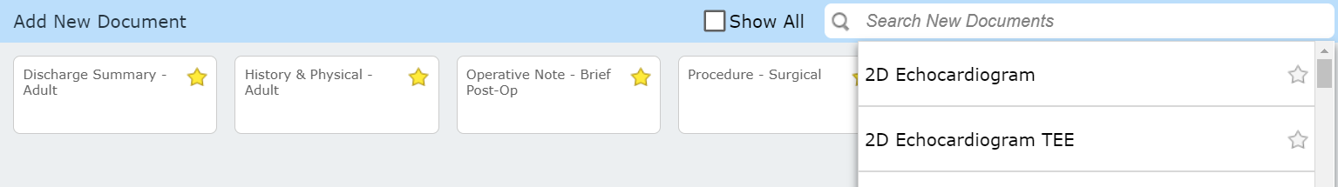
Document Navigating Document Screen
Document Screen
“Show All” (if checked) displays all documents in tile format (as favorites are shown below)
“Search New Documents” – lists documents while searching
Full list can be scrolled, or type to search
Documents can be made favorites
Click name to open document

Slide 6
Document Navigating Document Screen
Document Screen
All your favorite documents display as tiles
Click tile to open document type for the patient

Slide 7
Navigating a document

Slide 8
Document
We will be looking at the “History & Physical – Adult” document
Consult notes are constructed in a similar manner
Most documents will include some of these features, though less of them
Specialty documents are designed around their needs (the specialty)

Slide 9
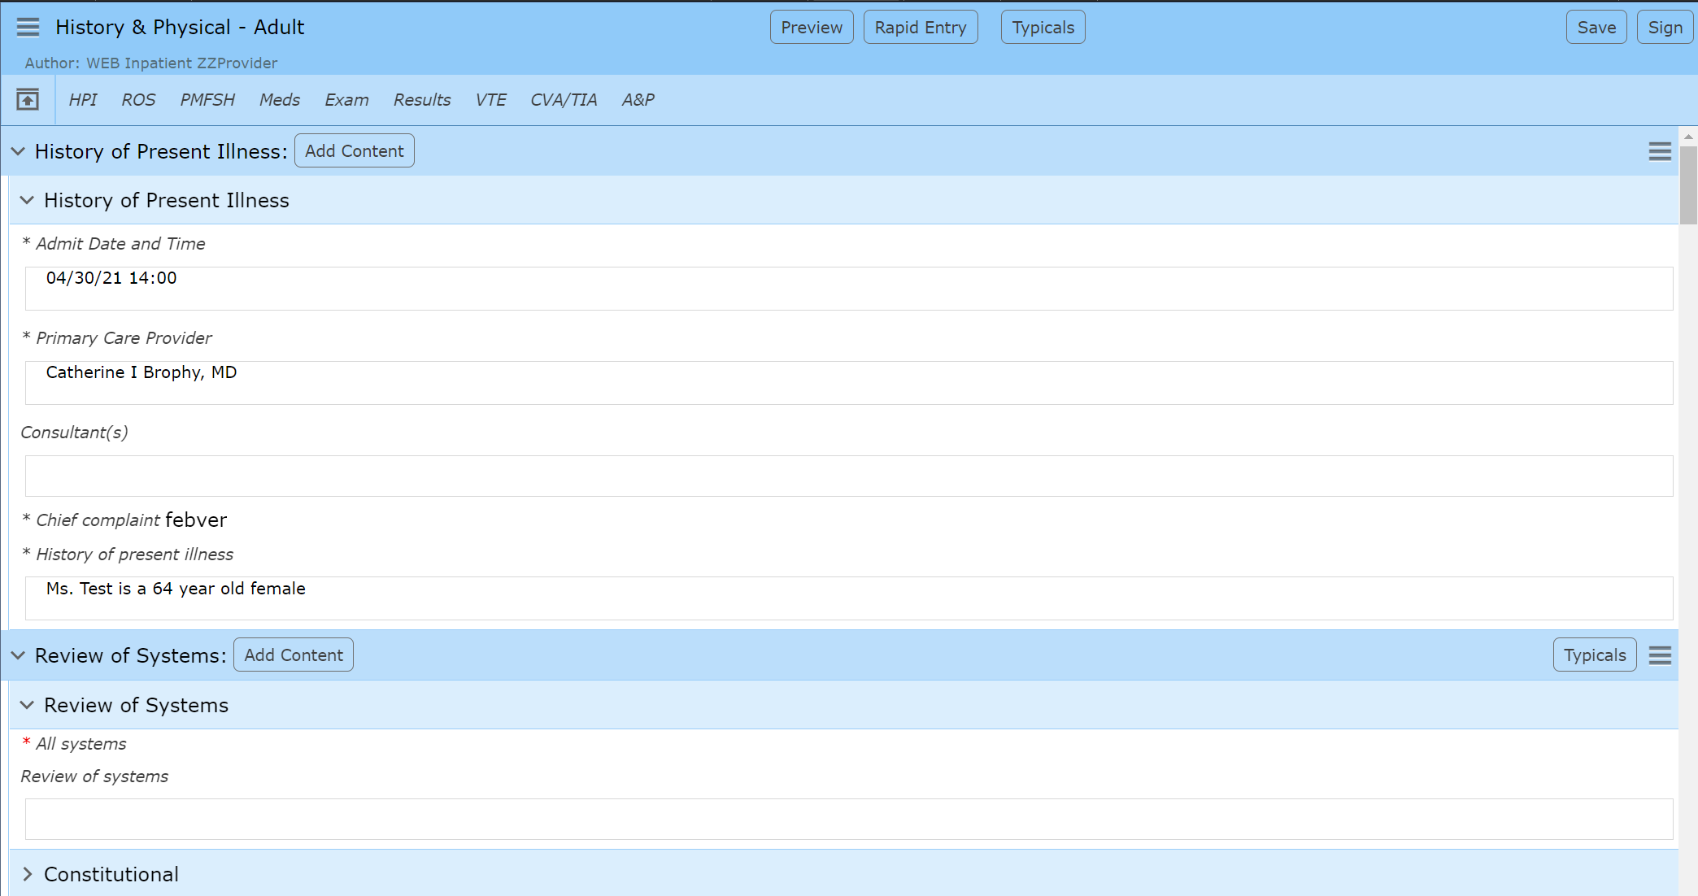
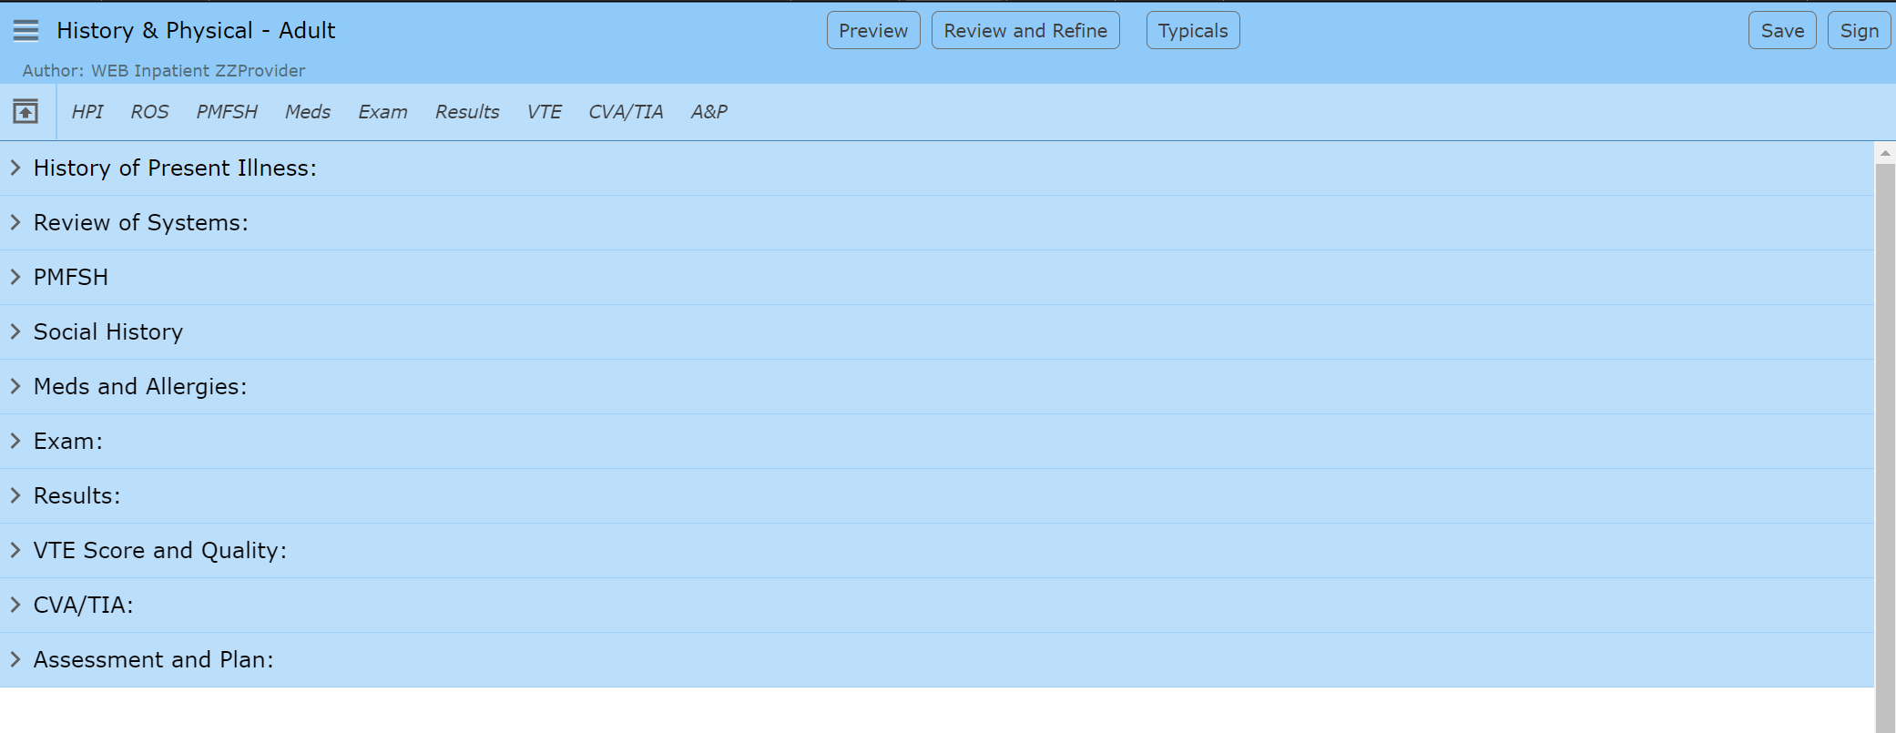
Document Navigating a Document
This is NOT the preferred view
Existing Documentation displays
Applied Typicals (Covered later)
Auto-fills
Pulled data
Questions/Queries must be opened to answer
An extra click for each answer
Toggle to default view “Rapid Entry”
Confirms Document Type selected
Confirms Provider who “owns” the document
Toggle to alternative “Review and Refine” view

Slide 10
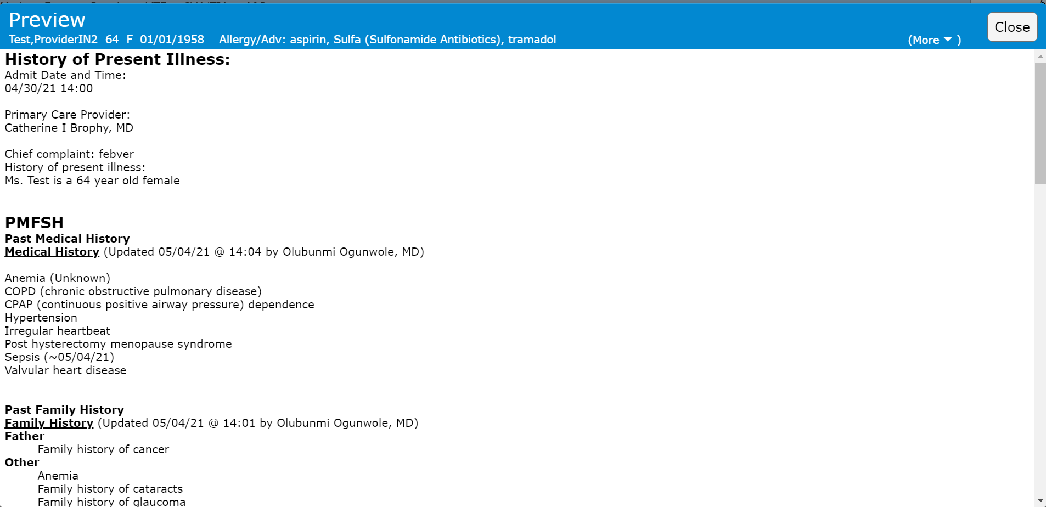

Document Navigating a Document
Click “close” to close pop-up Preview box
Typical allows you to choose which Typicals to add
This is covered under the Typicals section
Quick Save – Saves to a Draft Status
Auto Save IS enabled (~3 minutes)
If not “saved”, “Auto Save” saves to a pending status
Sign – Signs document to a final version
“Addendum” is the only option once saved
Preview – What Document will look like

Slide 11
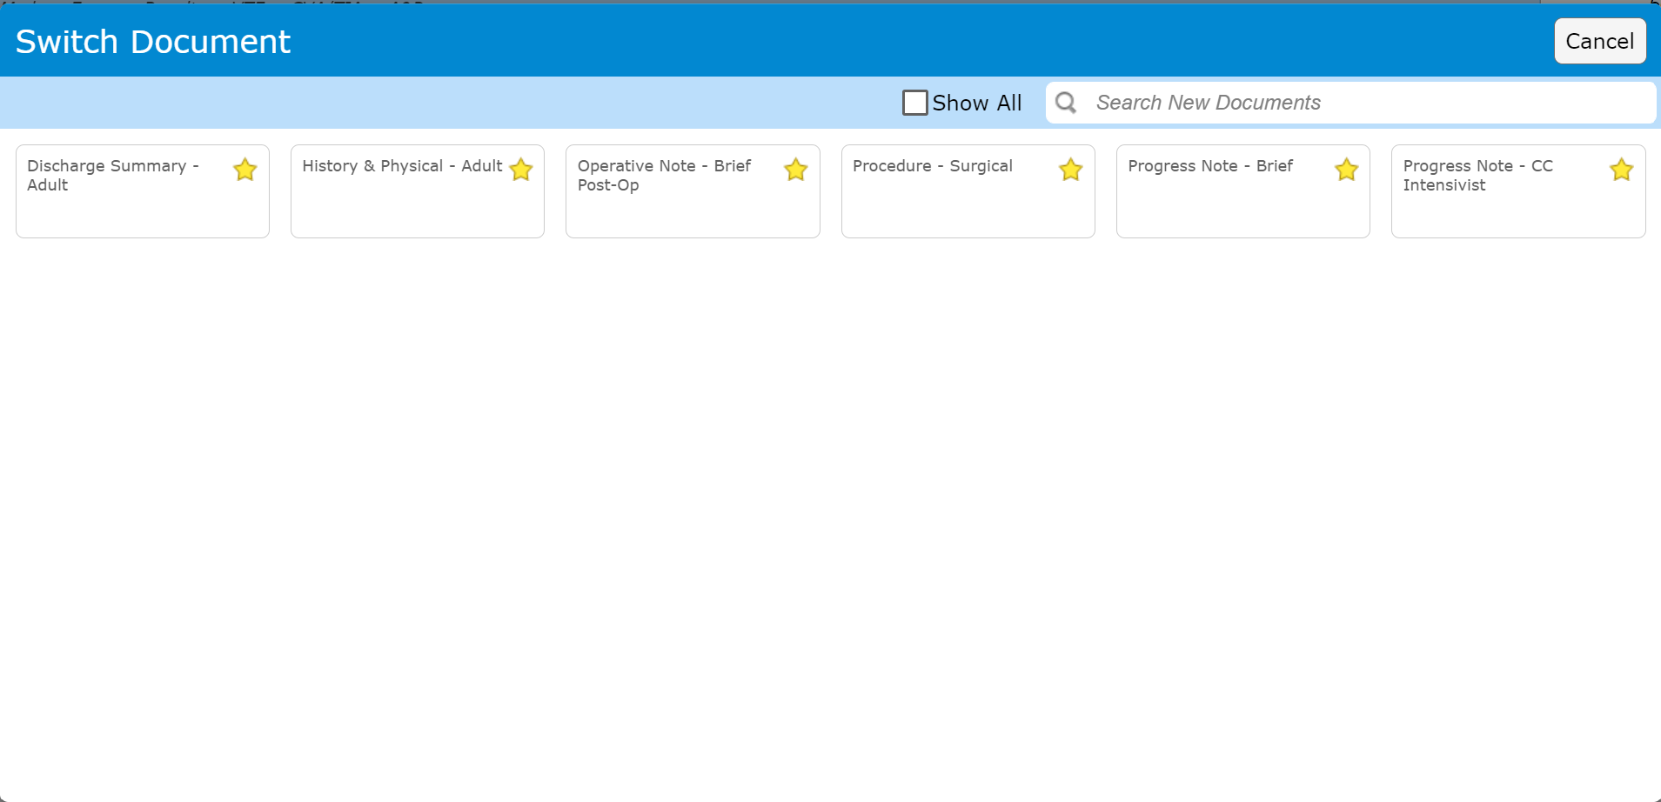
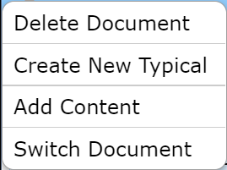
Document Navigating a Document
Menu
Delete Document
Draft and Pending documents only
Create New Typical – Covered in Typicals section
Add Content – Not recommended
Switch Document
Switches Document if Template selected incorrectly
Select from favorites or search for additional document types
**Warnings**
IF documentation has already been started
Documentation may be lost if those fields don’t exist in the new document type!

Slide 12
Document Navigating a Document
Typicals
Saved Documentation
Multiple can be saved
Specific to a document
Can be based on Age/Gender/Complaint, etc.
Indicates document sections that have “Typicals” content
Opens popup, where Typical may be selected as appropriate for situation

Slide 13
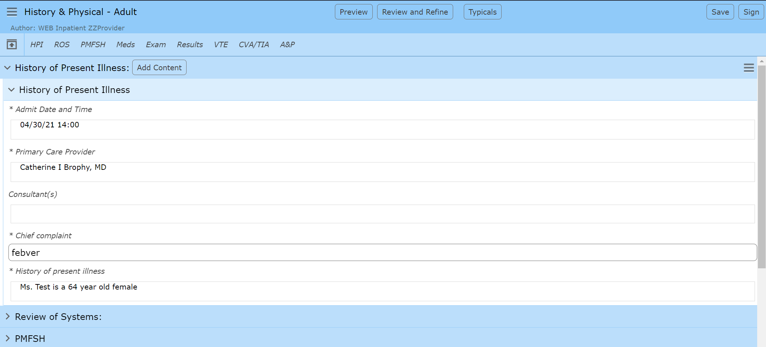
Document Navigating a Document
Open Section – Covered next
These are NOT tabs
These are Jump Headers
They open sections
Collapsing any existing open sections
Section Headers
May also be clicked to open
Collapsing any existing open sections

Slide 14
section

Slide 15

Document Section
“*” – Indicates Required question
Admit Date and Time
An example of content that defaults in
This text may be edited
Chief Complaint
Free Text – Unique field (Shared between all documents)
Chief Complaint Rules
Never delete previous entries (affects all future)
Add more specific diagnosis if needed “, MI”

Slide 16
Document Section
History of present illness
Canned text (specific for patient) inserted “Ms. Test is a 64 year old Female”
Canned text does not fulfill “required” documentation
Type or Dictate HPI to complete the requirement
Not recommended

Slide 17
Document Section
Moving to the next section
You can jump to any section using the Jump headers
You can click any section header that is visible
Regardless of the method
Only one section will display open

Slide 18
Review of systems

Slide 19
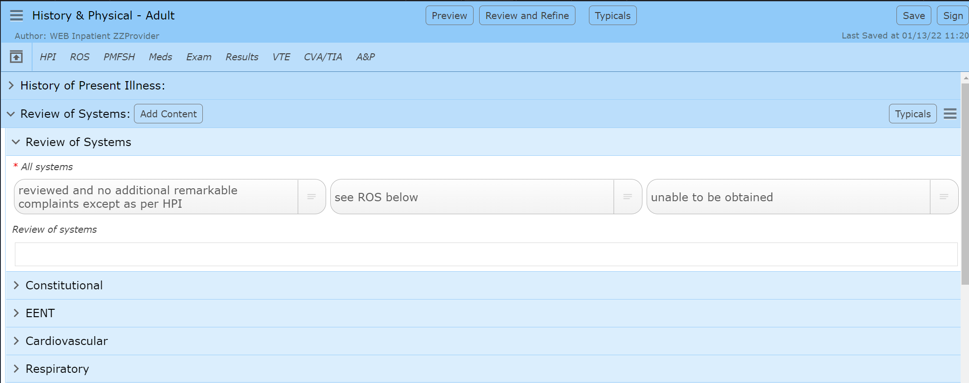

Document Review of Systems
Indicates Typicals are available for this section
Functions similarly to top “Typicals” button
Menu
Option to Clear Responses for entire section

Slide 20
Document Review of Systems
First question “All Systems” is required
Most frequently missed required question
Click to select
Click second time to deselect
Click to select and add Comment section
Text in comment box will display beside Answer
If clicked in error, the comment box may be ignored

Slide 21
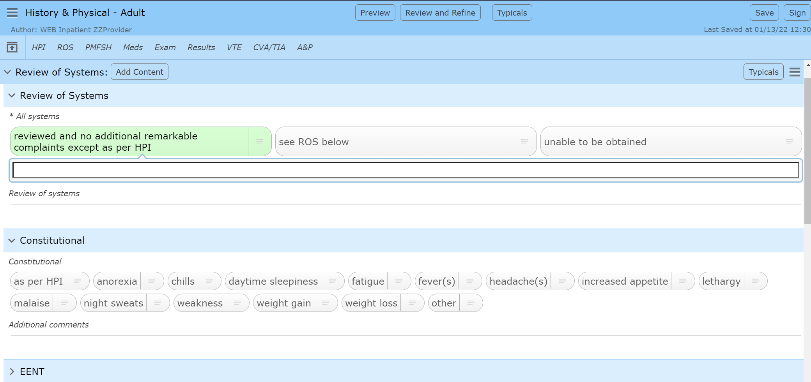
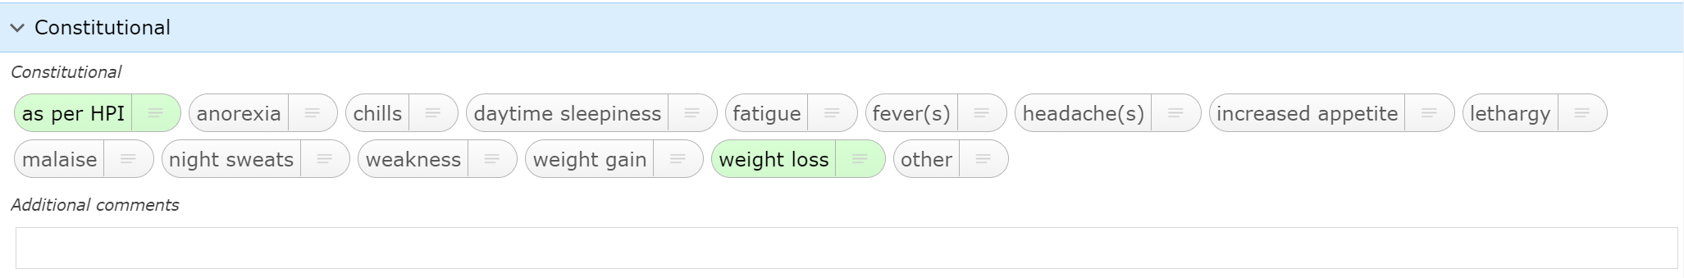
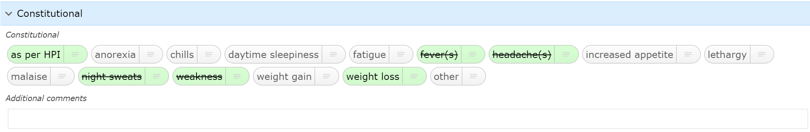
Document Review of Systems
Dragon Dictation Box
Use Dragon Auto-Texts or dictate directly
Answers may be left-clicked for positive response
Answers may be Right-clicked for pertinent negative responses
This option is not available outside of ROS and Exam
Individual Systems must be clicked to open

Slide 22
typicals

Slide 23
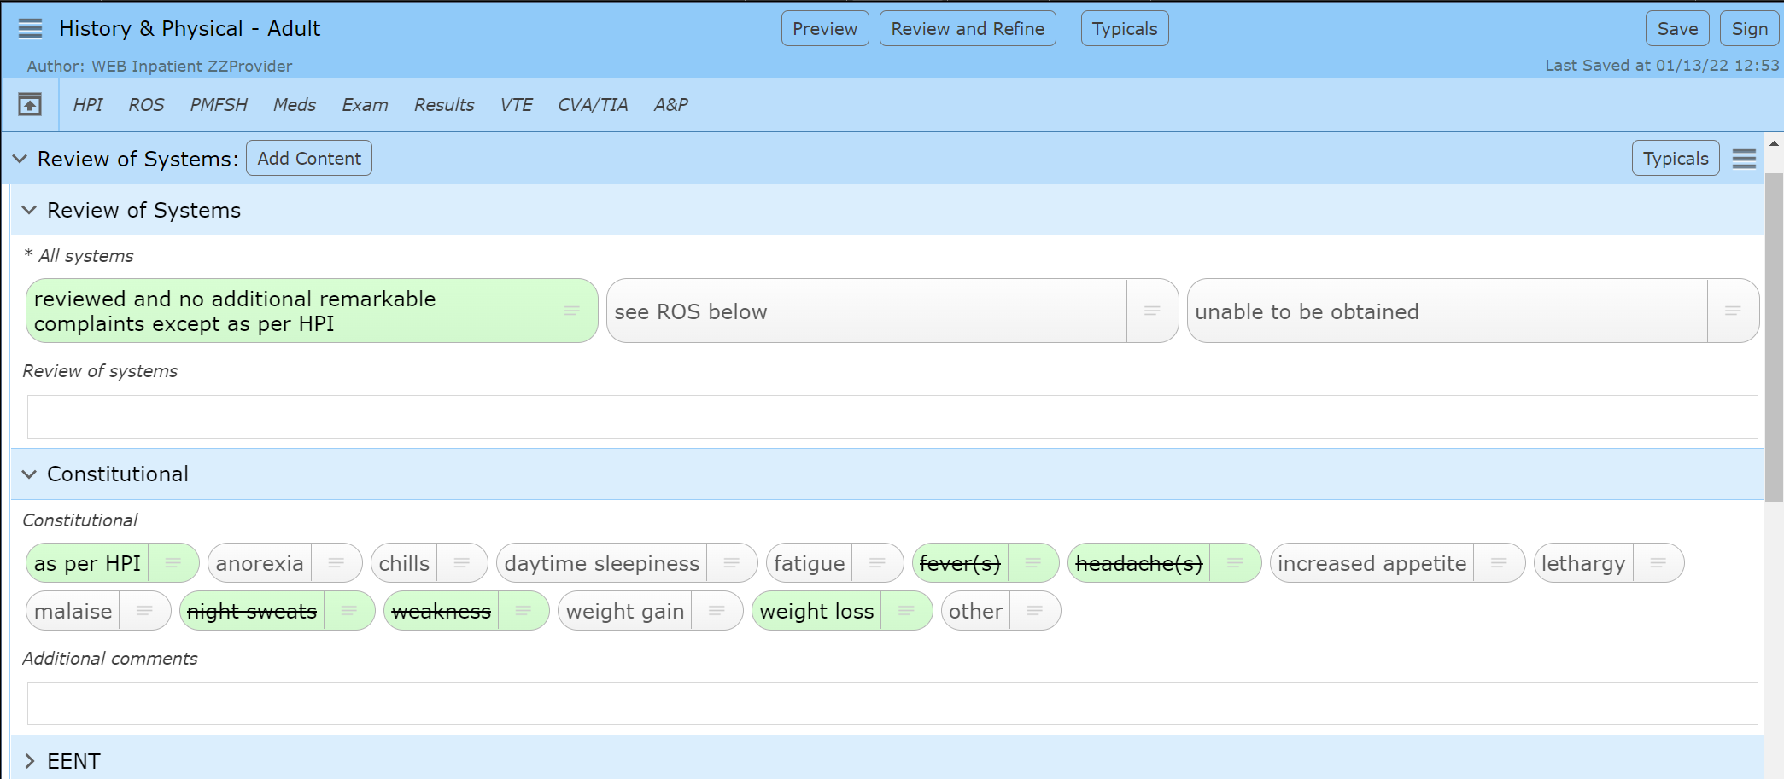
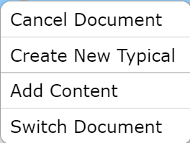
Document Creating a Typical
At any time within a document
Click “Typicals” (Either if open section has button)

Slide 24
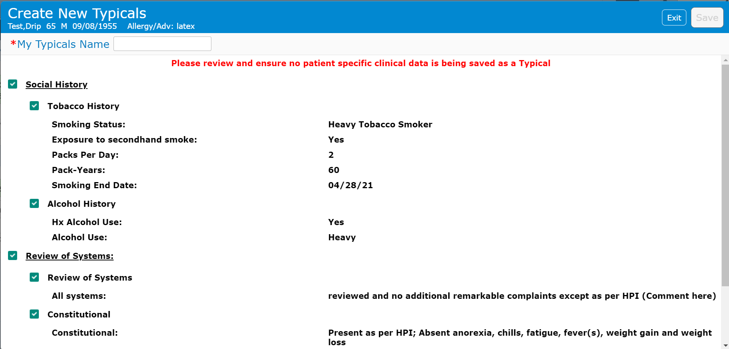
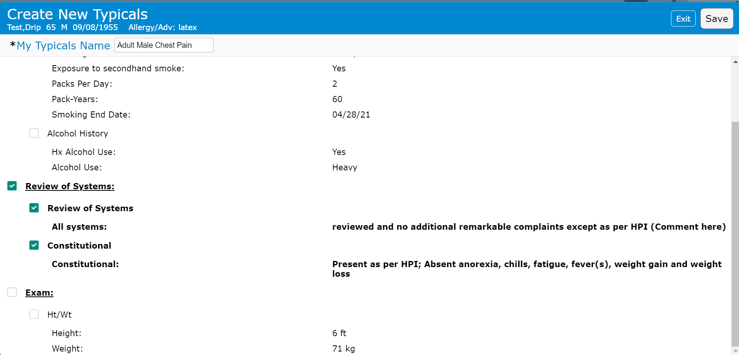
Document Creating a Typical
The “Create New Typicals” Popup
Social History unchecked (one click at system name)
Scrolled down
Unchecked “Exam”
It only included the patient specific Ht/Wt
Left ROS alone
Added the name
Save is now available to be clicked
Rules for creating a Typical
All patient specific sections MUST be unchecked
Social History etc.
Scroll down to check below
Only keep the intended sections
ROS and/or Exam are normally used
Name the Typical
usually includes intent i.e., “Adult Male Chest Pain”
Save the Typical
usually requires clicking out of the name
Typicals can be edited later

Slide 25
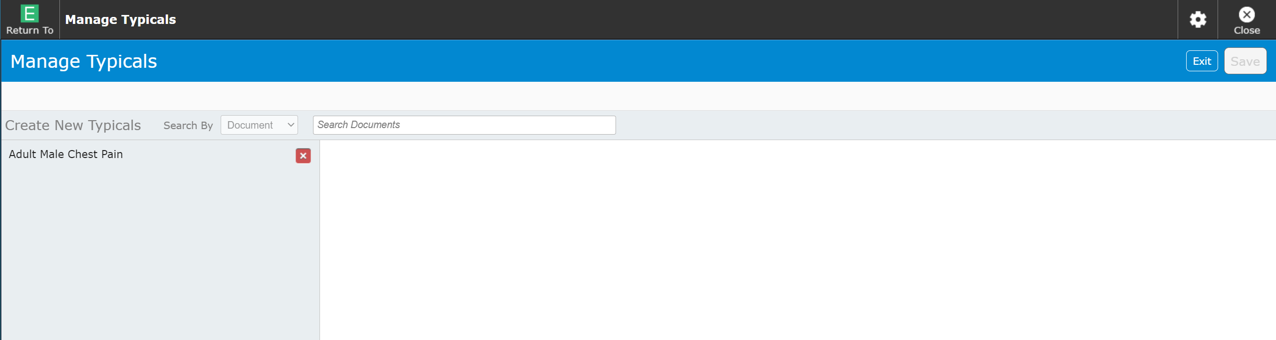
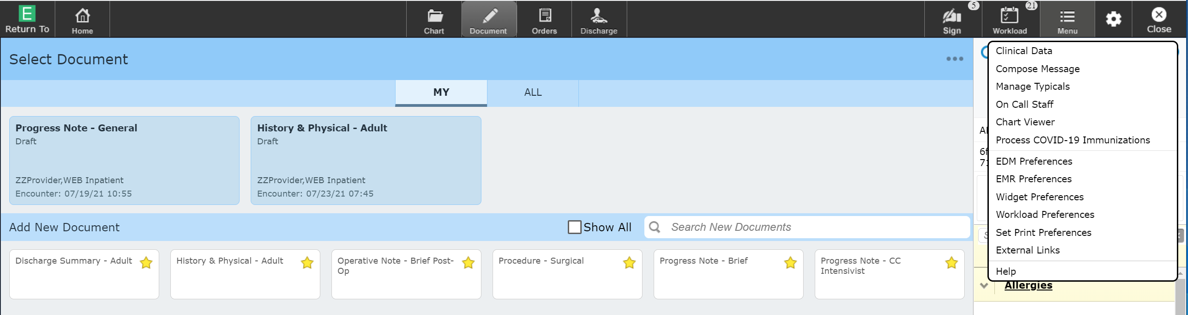
Document Managing Typicals
Managing Typicals can be done at any time while logged into Expanse Web
Click “Manage Typicals” on the Menu options
Saved Typical
Click name to edit

Slide 26
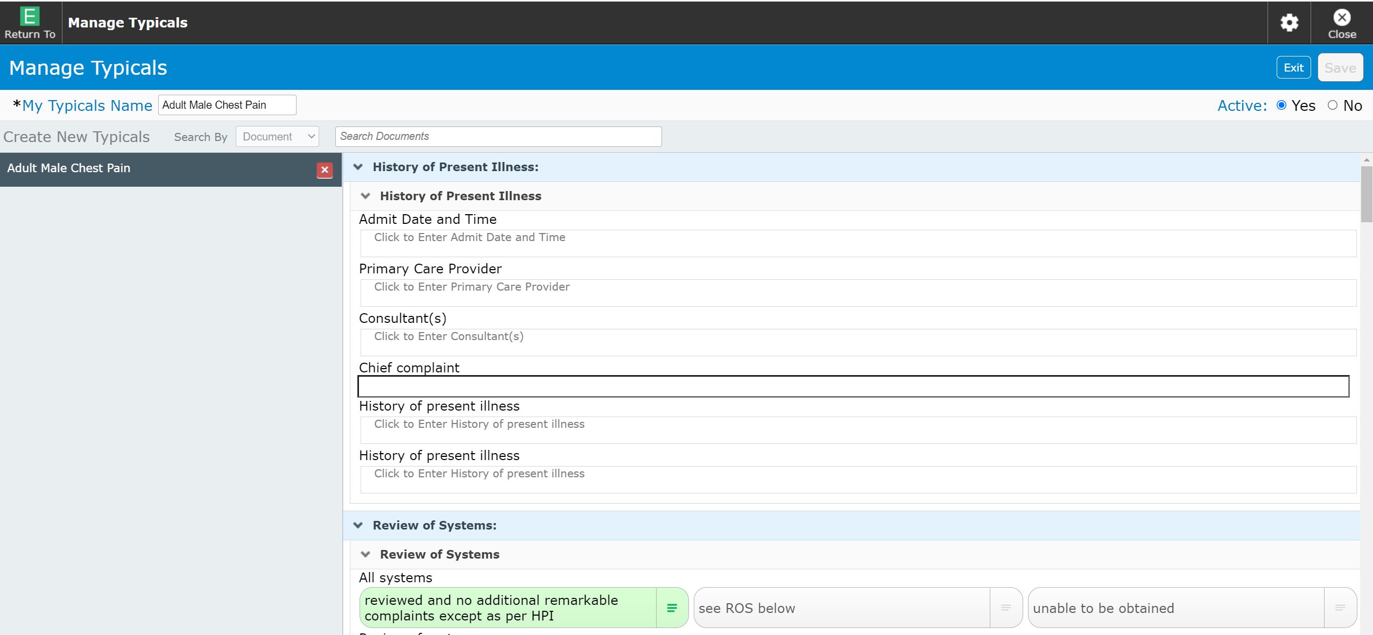
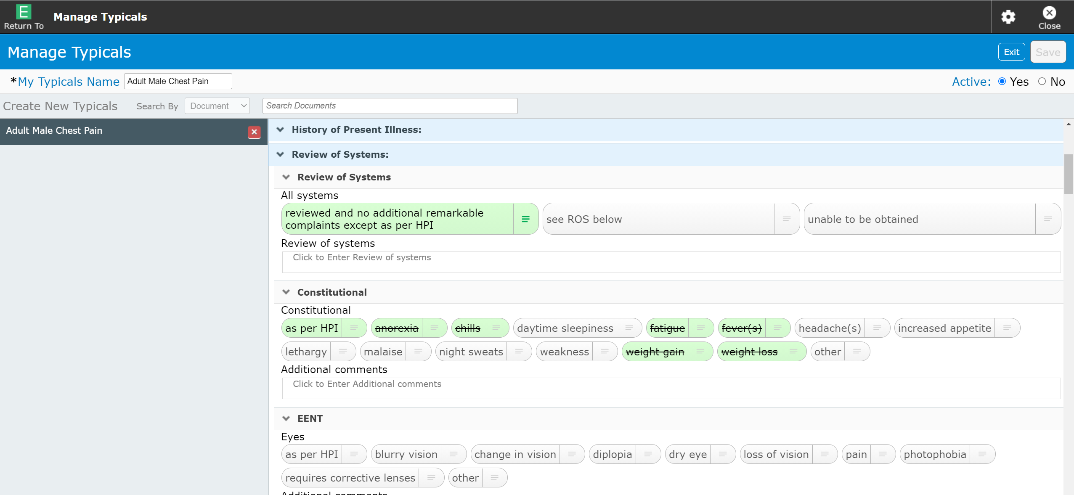
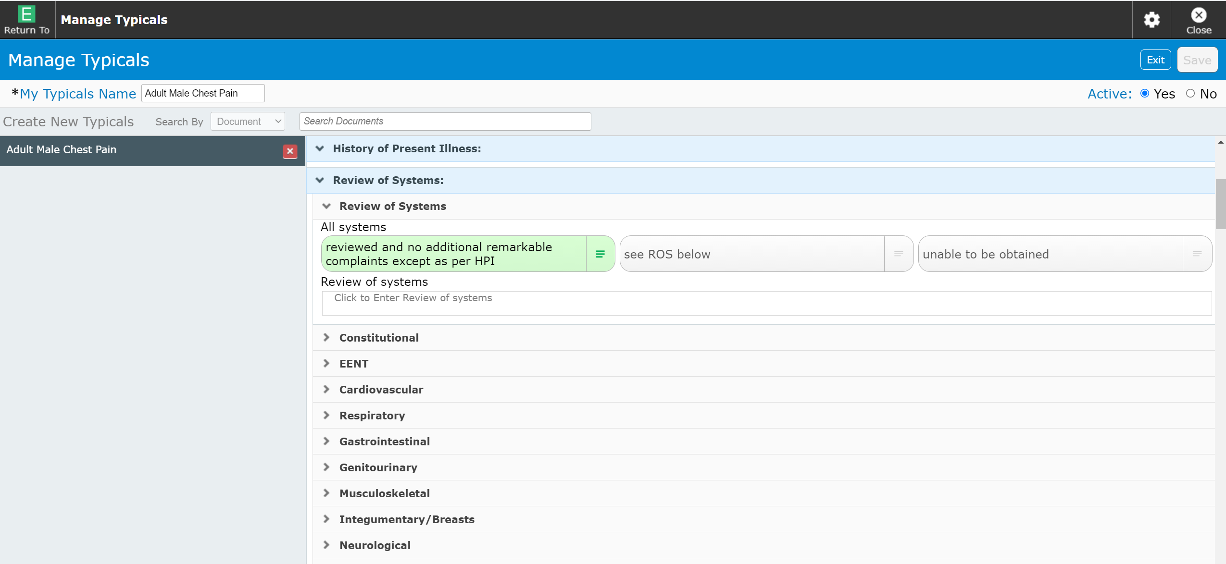
Document Managing Typicals
The Entire Document opens and is available for editing
Click “X” to delete Typical
Save to finalize
Systems default to collapsed
Each system must be opened to edit them

Slide 27
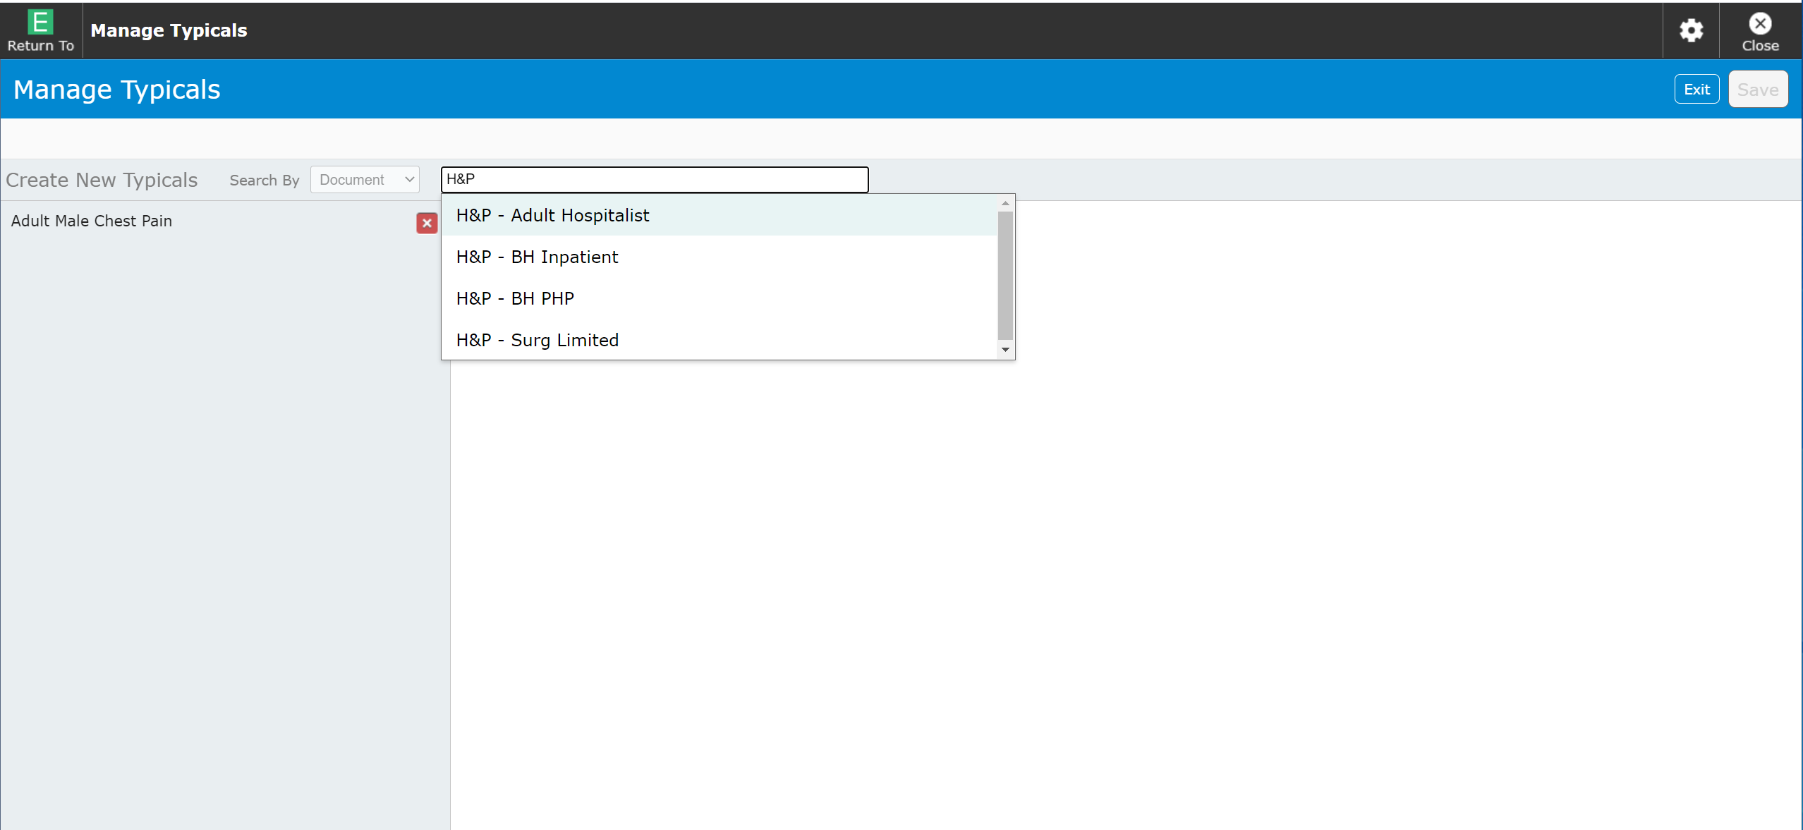
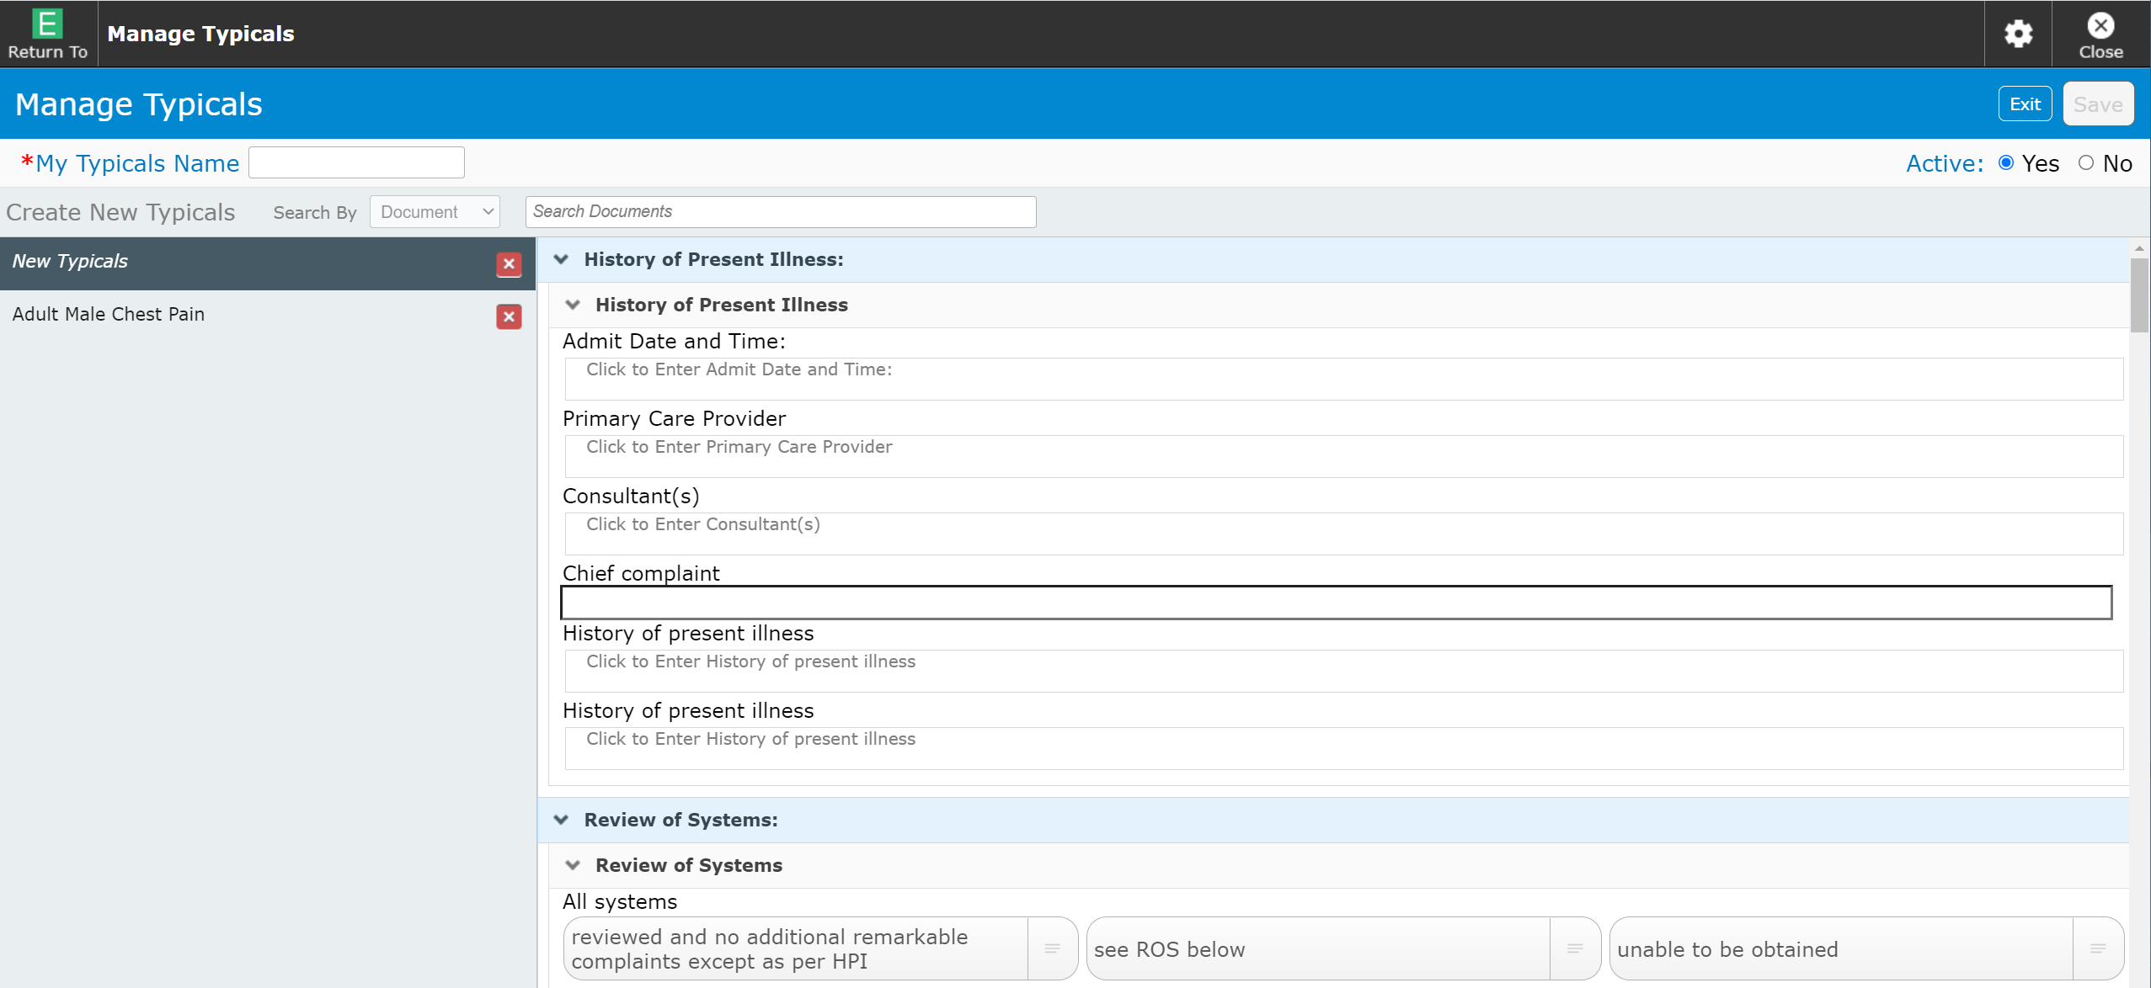
Document Creating a Typical within Manage Screen
Click into the search box and start typing
After selecting the desired document
The Document is open for Editing
Make Edits as desired
Enter a name
Save
Key words to search
“H&P” OR “History” for H&P’s
“Consult” for Consult Notes
“Progress” for Progress Notes

Slide 28
pmfsh
Patient Medical Family Surgical/Social History

Slide 29
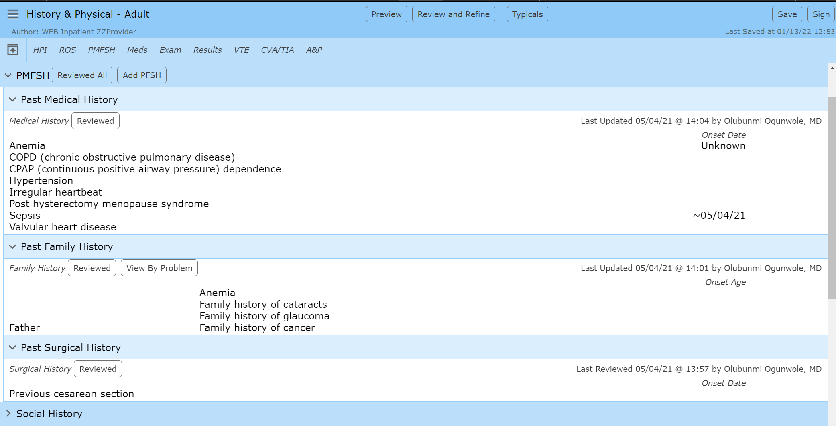
Document PMFSH
Documents all Medical/Family/Surgical Hx as reviewed
NOT a recommended practice
Individual “Reviewed” documentation
Limited use (Family/Surgical possibly)
Click anywhere into this area to open the Edit screen
Area may be small if no Hx
Medical & Surgical are the same Edit screen

Slide 30
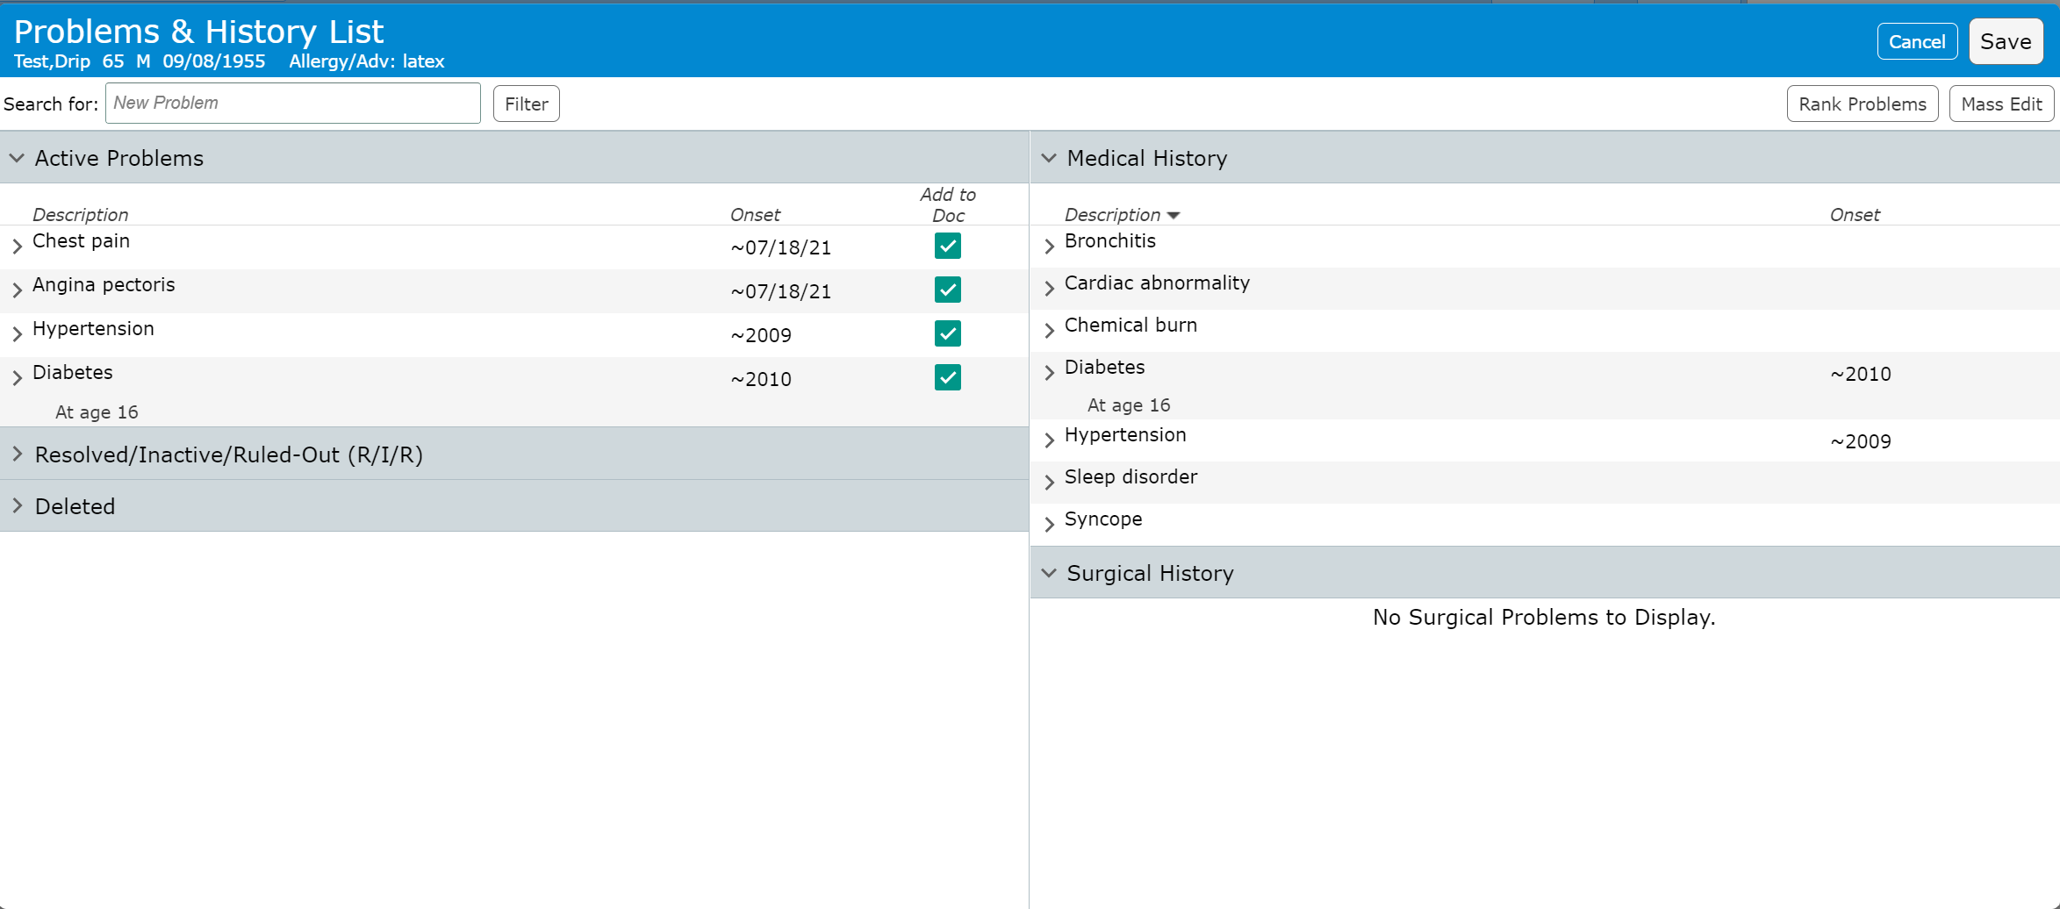
Document PMFSH
Patient Medical & Surgical History
Active problems – For this visit (ideally)
Medical History – Chronic or significant Hx
Surgical Hx – Surgical procedures
Resolved/Inactive/Ruled-Out – All previous except deleted
Deleted – Problems entered in error
Rank/Sort Active problems by priority

Slide 31
Document PMFSH
Patient Medical & Surgical History
Active problems are linked to Medical History
Note that Hypertension and Diabetes are in both sections
They are the same problems displayed in both locations
“Add to Doc” – Adds problem to A&P
Preferred way to add problems

Slide 32
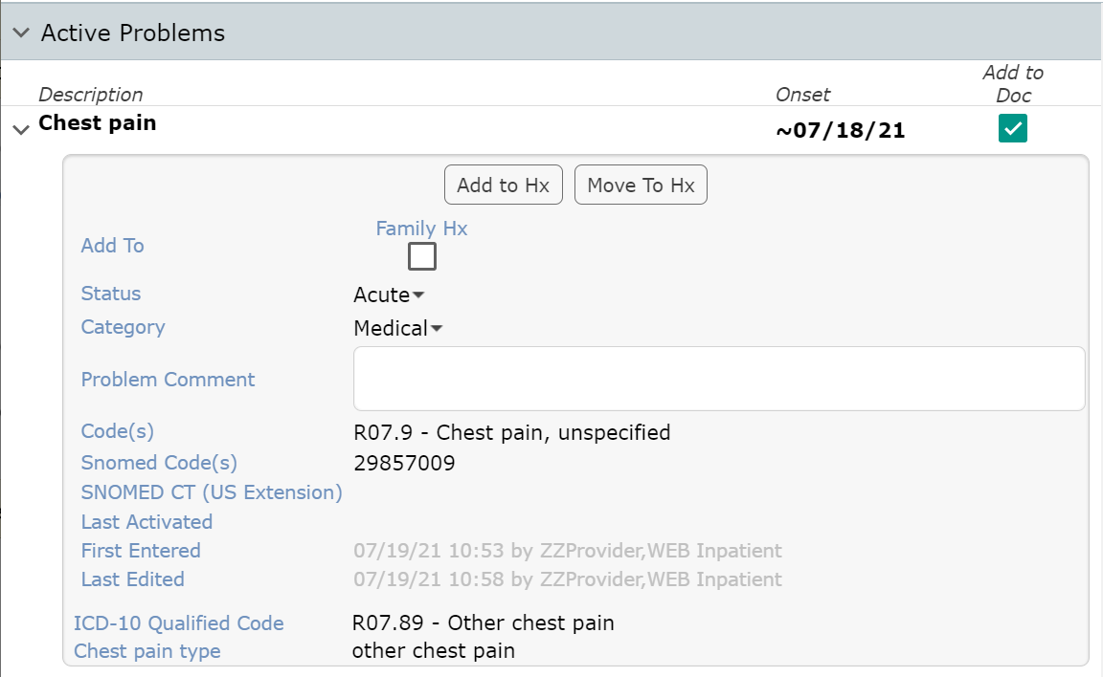
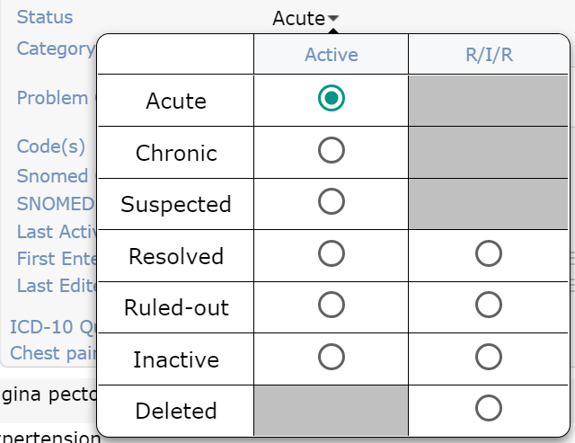
Document PMFSH
Active problem details
“Add to Hx” – Problem also shows in Hx, “Linked”
“Move to Hx” – Problem moved and only displays in Hx
“Add to Family Hx” – not the recommended process
Status – Displays as Acute
Acute/Chronic/Suspected
Resolved/Ruled-out/Inactive
Active and Past (R/I/R column)
Deleted

Slide 33
Document PMFSH
Active problem details (continued)
Category
Medical – Almost all problems default to Medical
Surgical – Surgical procedures default to Surgical History if in History
Social Hx – Not used (Documented in its own section)
Problem Comment
Rarely used
Surgery Hospital?

Slide 34
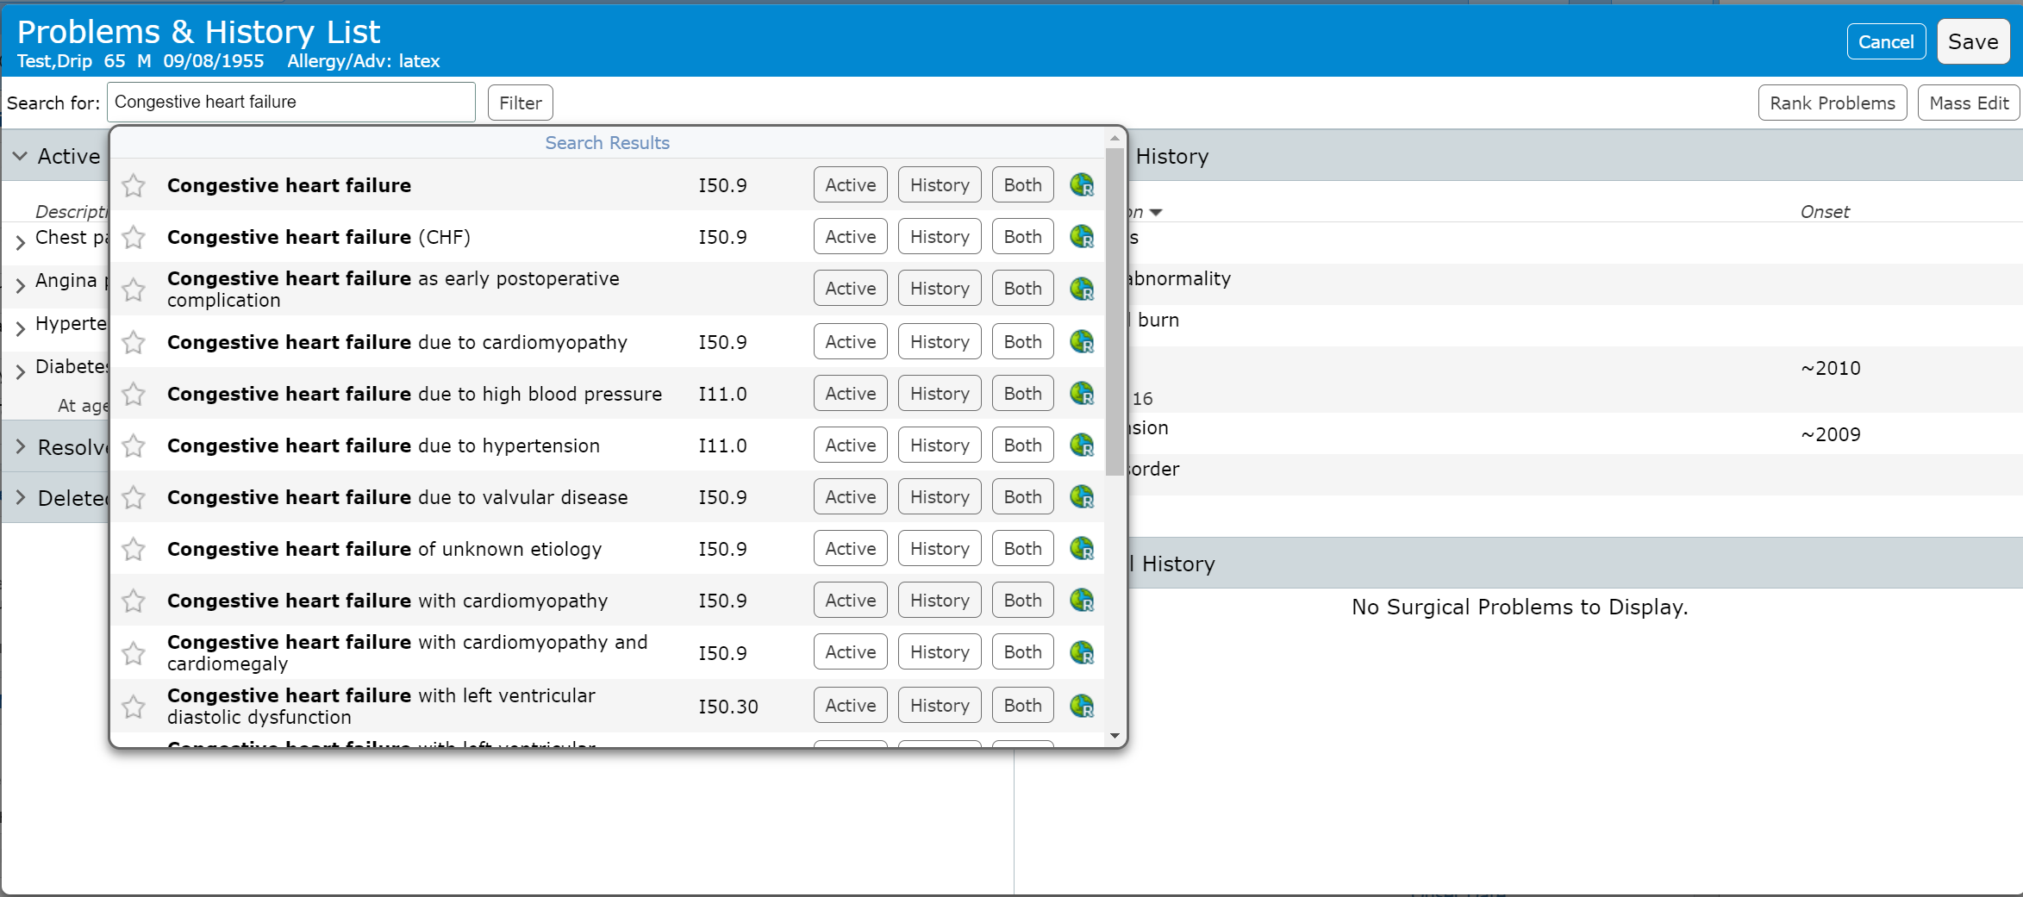
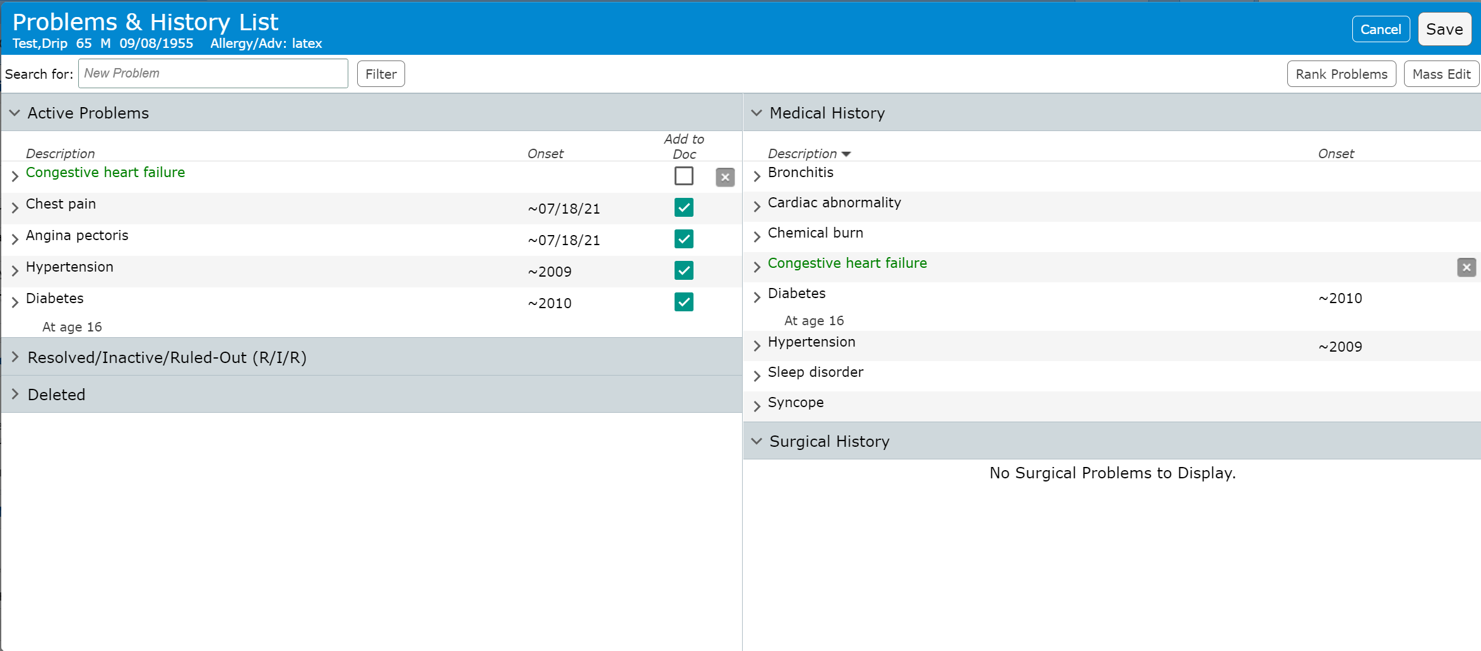
Document PMFSH
Adding a problem
Click Save when Done
Type in a diagnosis (and pause)
Abbreviations usually are acceptable
Search results display after pause
ALWAYS choose basic diagnosis
Duplicates are blocked
Existing Hx can be added to active
Location buttons (where to add)
Active – visit specific problem
History – Only to record History
Both – Chronic problem being actively treated
Up-To-Date link for problem
Duplicate problems may be under Resolved/Inactive/Ruled-out
The problem can be made Active from there
Don’t forget to check “Add to Doc” box if not automatically added

Slide 35
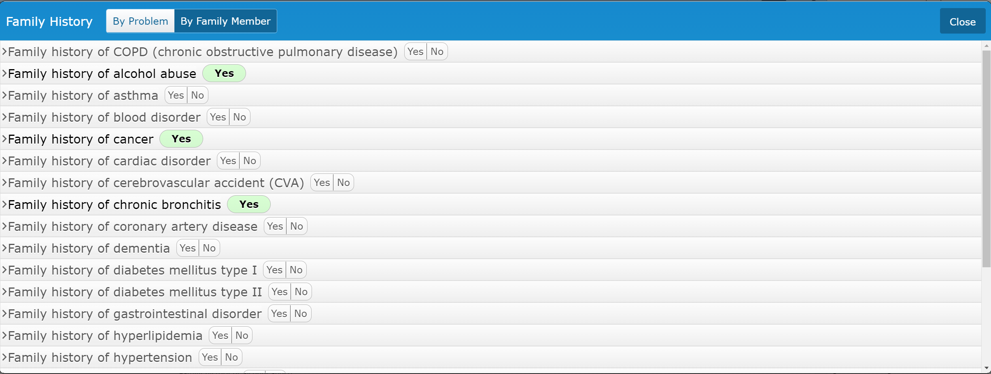
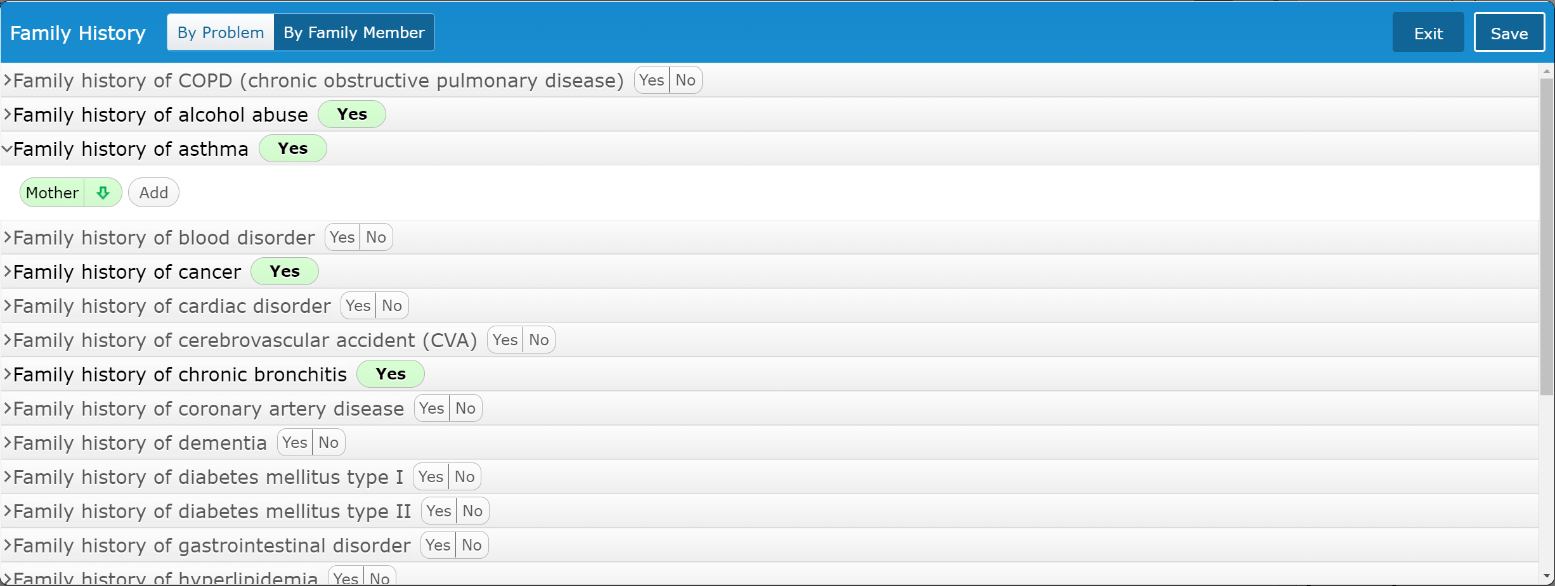
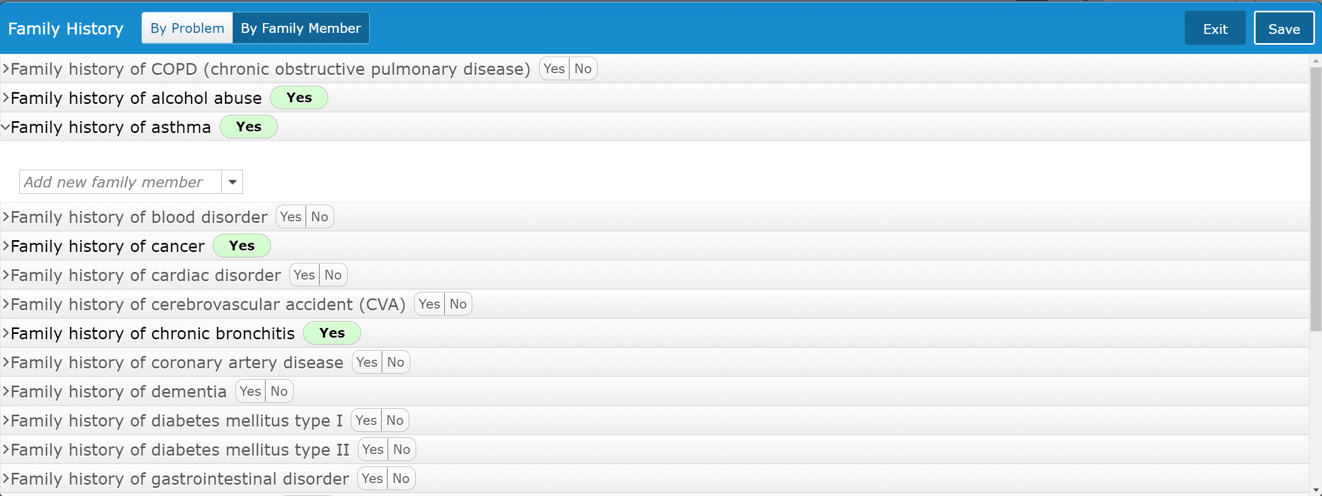
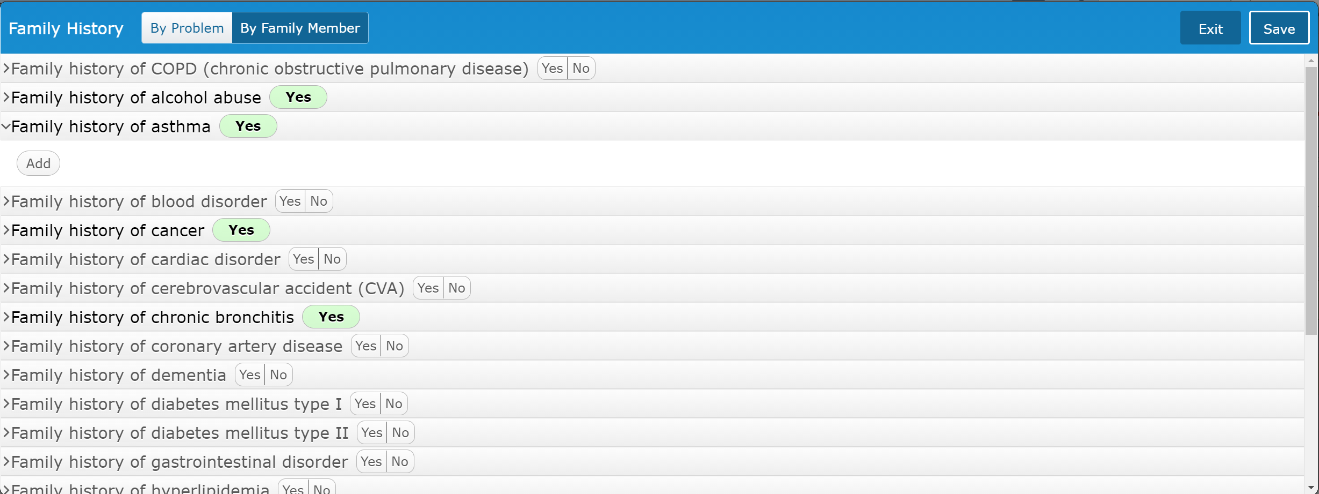
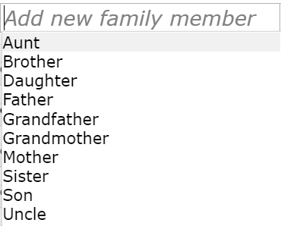
Document PMFSH
Family History
Includes a list of common Family Hx problems
Click “Yes” to add family History
The Family Hx has been added
Optional
Add details on which family member
If family member had been specified previously (for any other family Hx)
Those family members display
Click “Add”
Select Existing family member (if any), or
Click to select New Family member

Slide 36
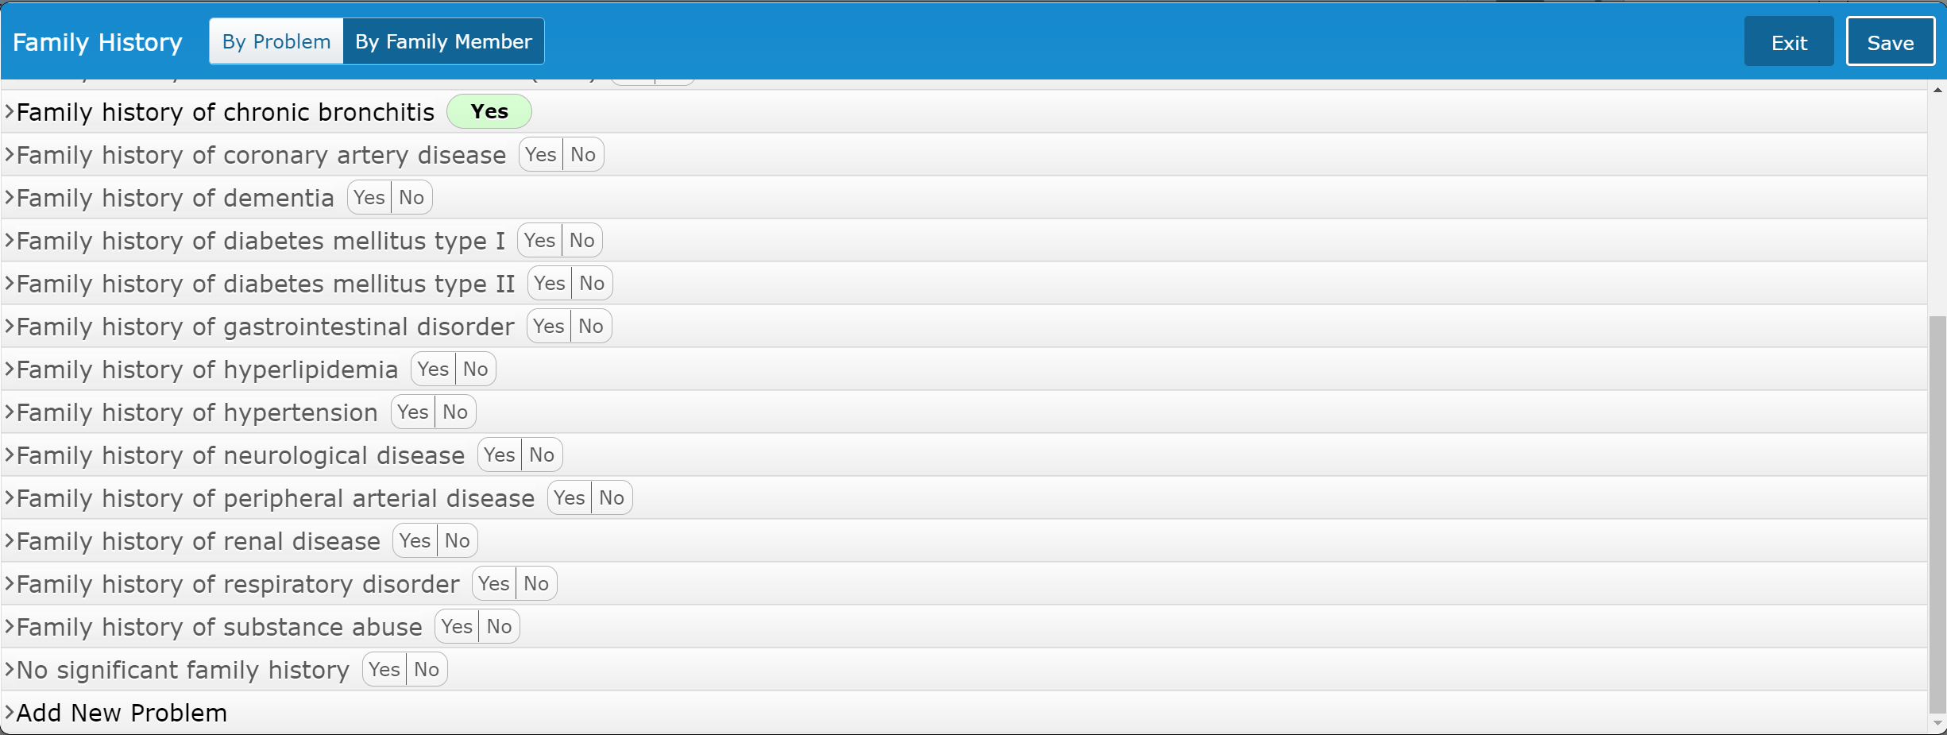
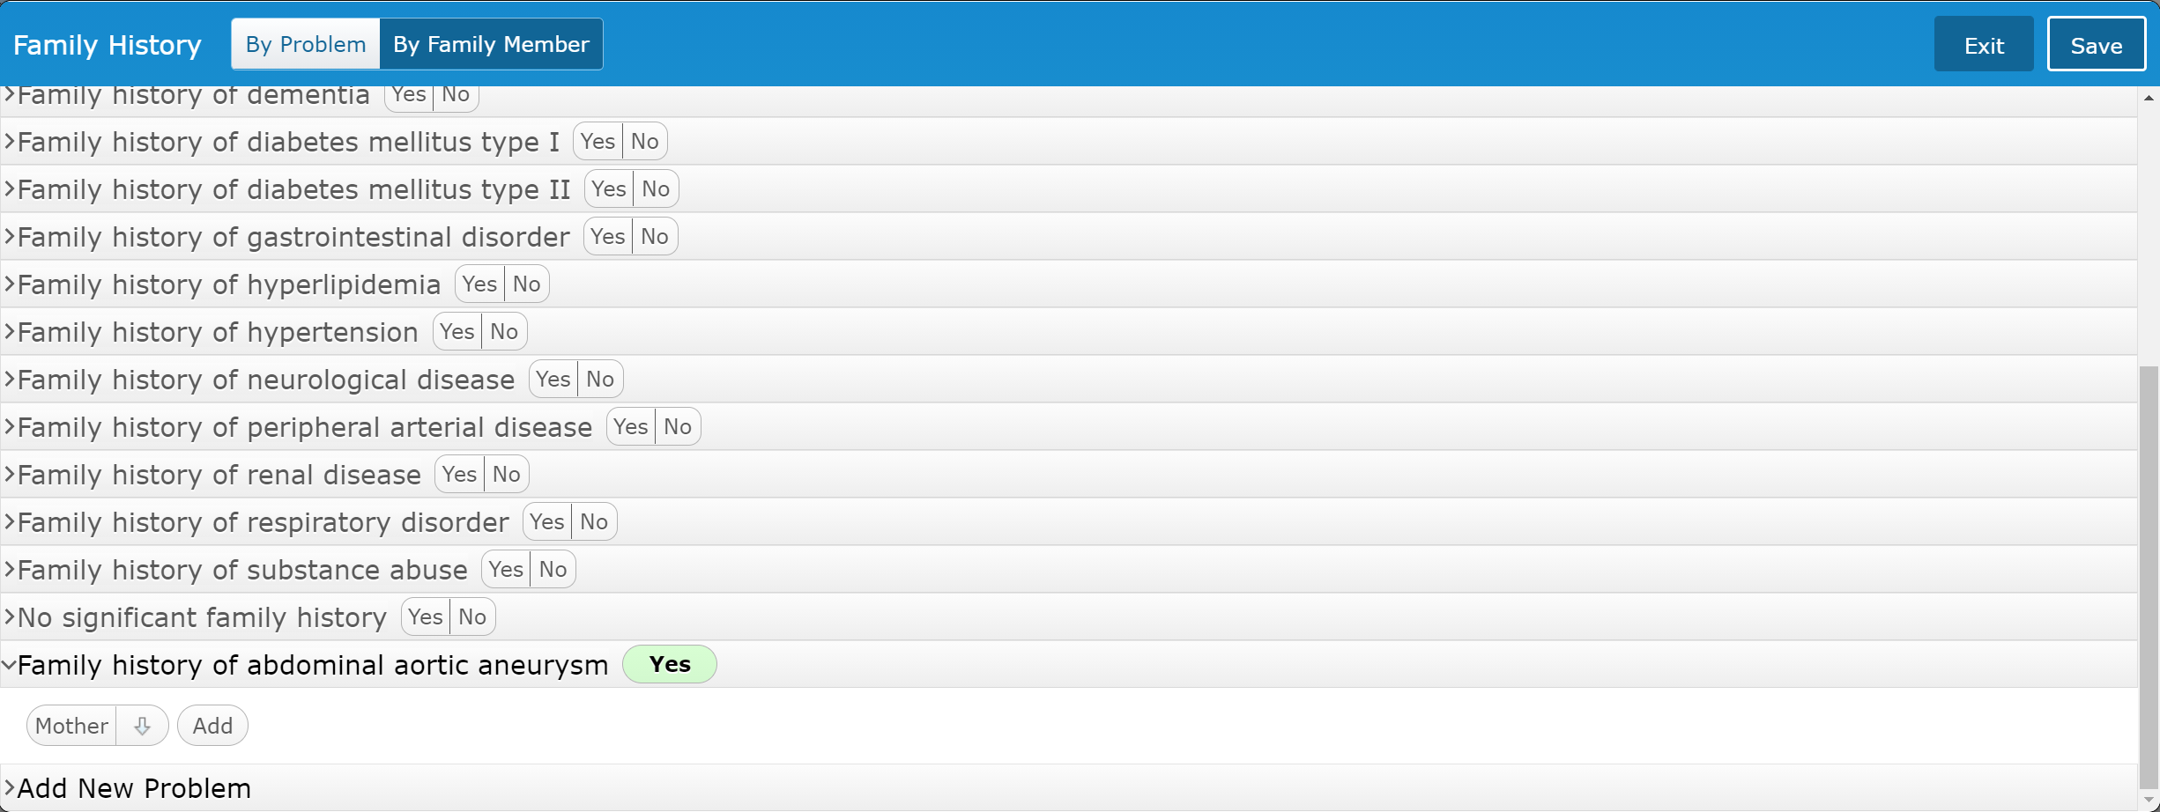
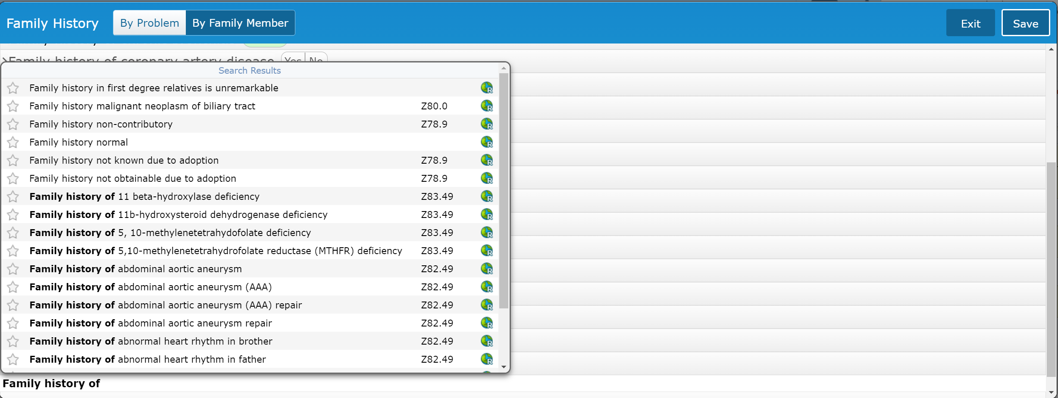
Document PMFSH
If No Family History
No Significant Family History
To Add a Hx not on List
Search using “Family History of” format
Keeps format consistent
Select desired Hx

Slide 37
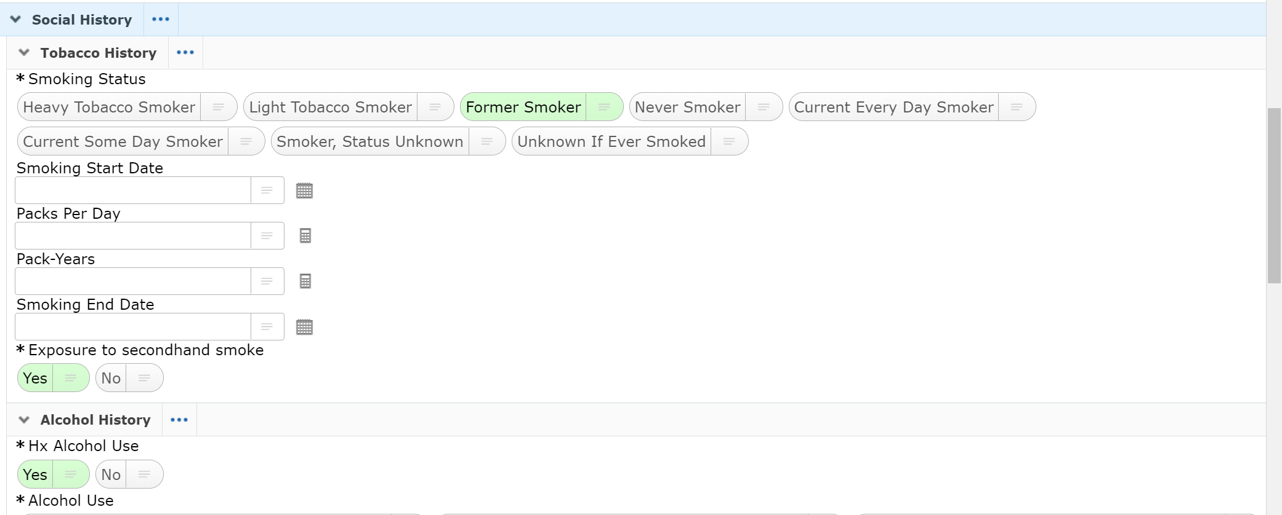
Document PMFSH
Social History
This is a shared section with nursing
If completed by nursing the data pulls in
If your assessment differs from the nurse
The selections can be changed
It doesn’t affect the nurse’s documentation

Slide 38
Meds (Allergies & Home medications)

Slide 39
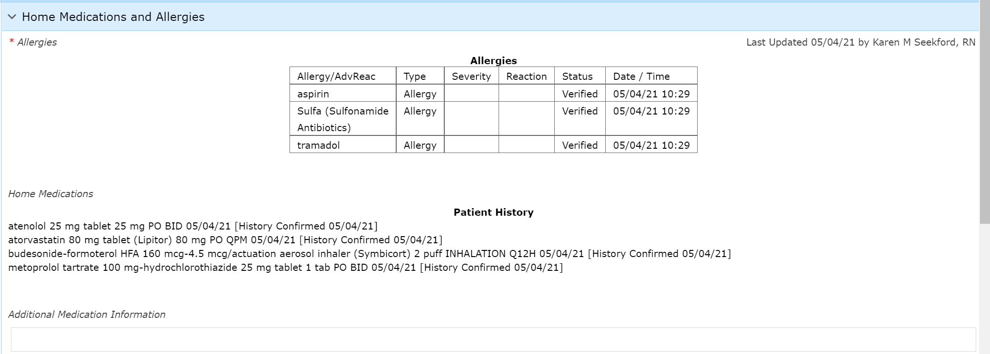
Document Meds
Allergies and Medications (Under Meds)
Data is automatically pulled in
Home Meds don’t pull in if patient discharged before document opened

Slide 40
Document Meds
Click into areas to edit
You will be taken to Nurses Desktop view for each section

Slide 41
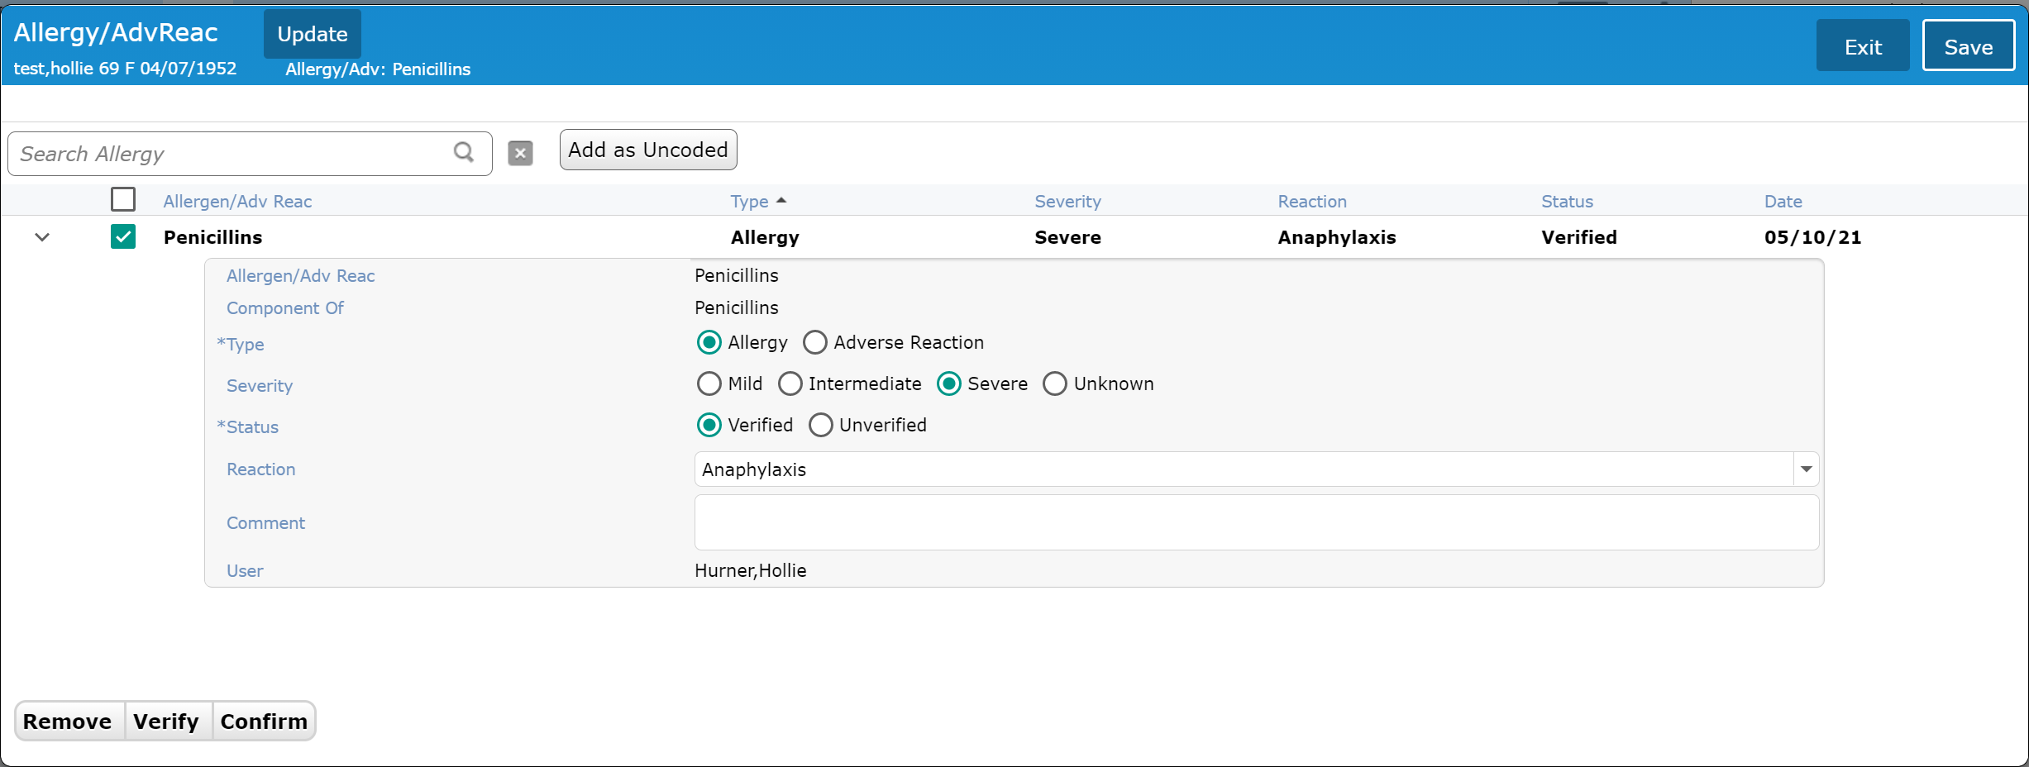
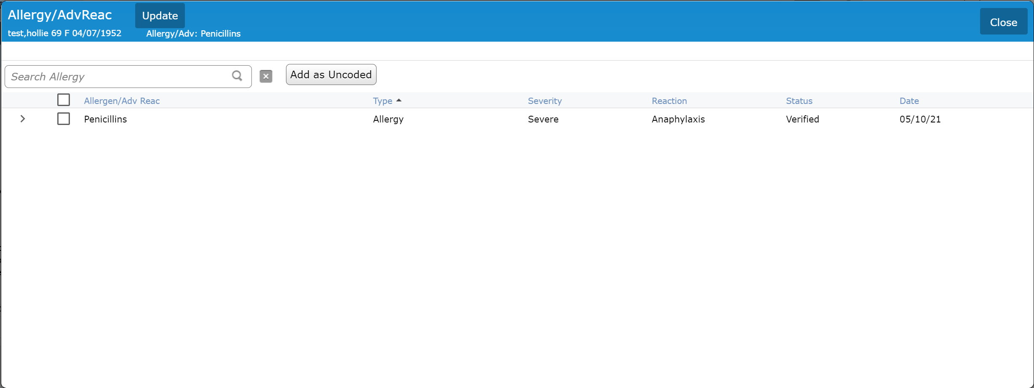
Document Allergies
Allergies Edit screen
Completed by nurses usually
Click on line (except check box) to expand
Options when check box checked
Fields completed for allergies
Always an Allergy
Always Severe (provider can edit)
Always Verified
Reason from drop down list
Comment if needed

Slide 42
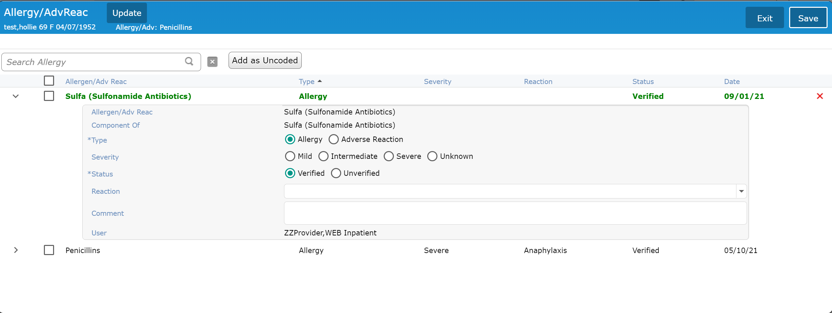
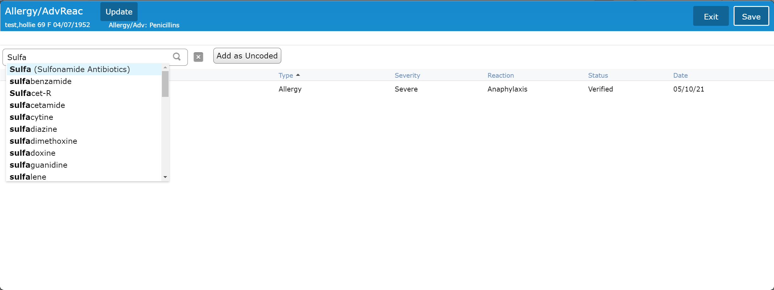
Document Allergies
Adding a new allergy
Type Allergy
Drop down displays options when enough characters entered (Select)
Enter additional information
Add additional allergies
NEVER enter as Uncoded
Save when done

Slide 43
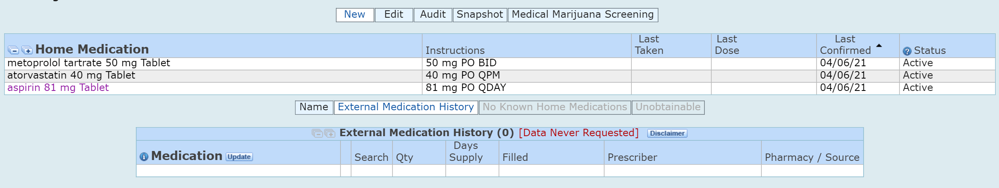
Document Home Medications
Home Medications Edit
Normally only done by nursing
Prescription Hx available
“New” and “External Medication History”
Rx history displays for previous year

Slide 44
Exam

Slide 45
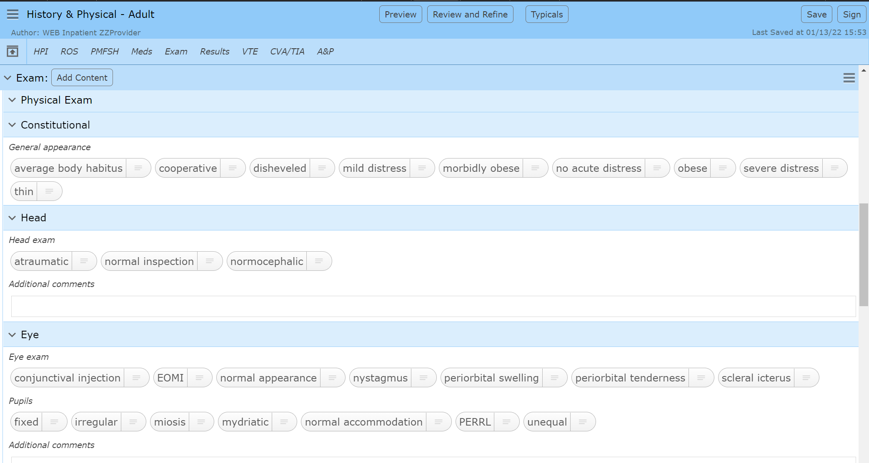
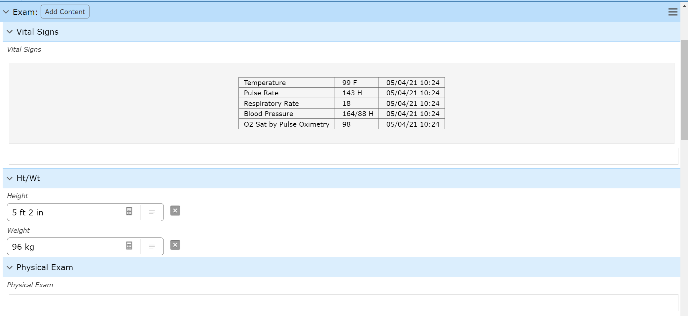
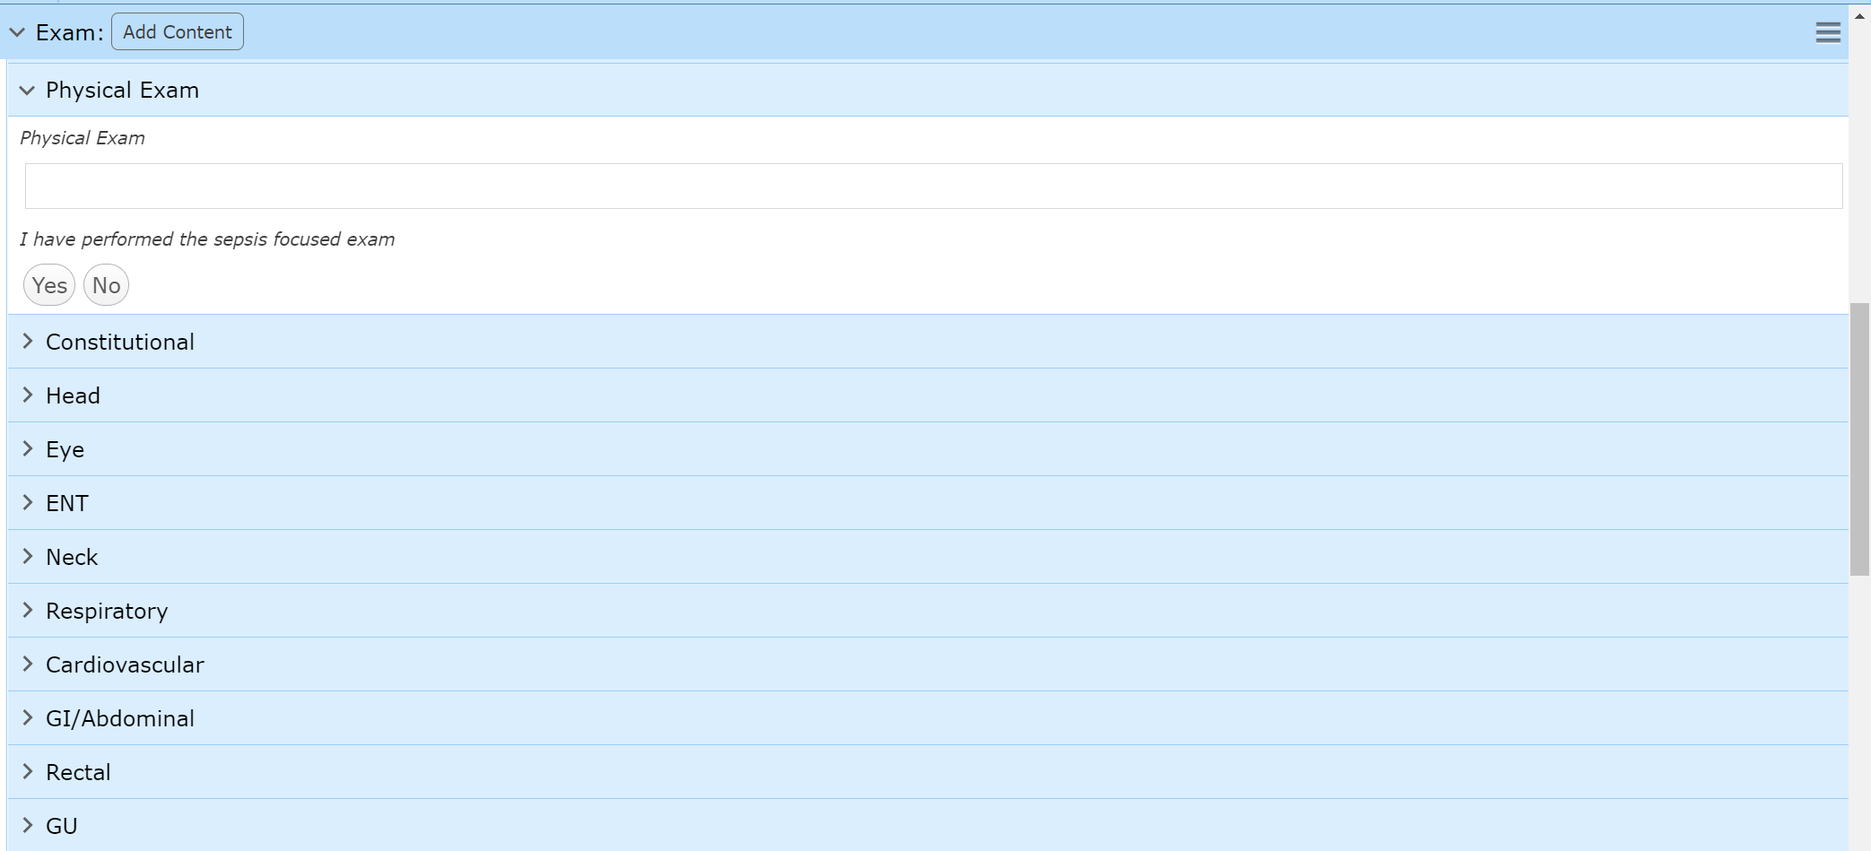
Document Exam
Sepsis focused exam question
Individual sections must be clicked to open
Similar to ROS
Right-Click not enabled
Typicals could be used for the exam
But shouldn’t include VS and Ht/Wt
VS data pulls in
Additional data may be entered if needed
Ht/Wt data (Last recorded) pulls in
Dragon dictation area for exam

Slide 46
results

Slide 47
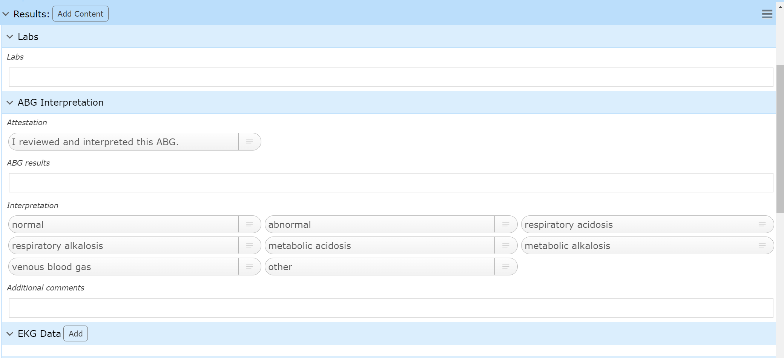
Document Results
Labs pull in – Usually last 72 hours
ABG Interpretation
Document if indicated

Slide 48
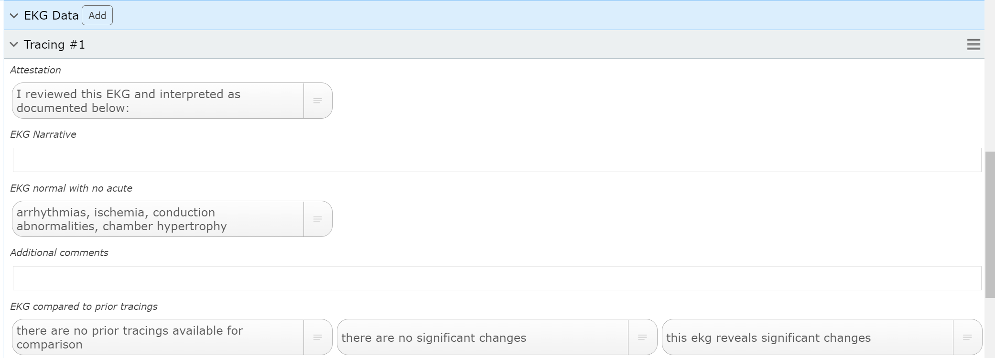
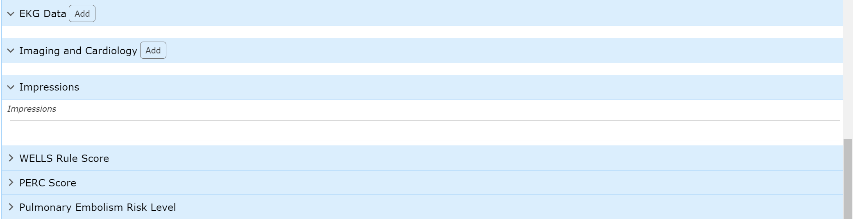

Document Results
EKG Data
Click “Add” for documentation “Instance”
Choose the appropriate Tracing (Multiple can be documented one at a time)
Document appropriately and “Add” tracing if needed

Slide 49


Document Results
Imaging and Cardiology
Click “Add” for documentation “Instance”
Choose the appropriate Study
Document appropriately and “Add” study if needed
Impressions
Pulls Clinical Impressions from signed Radiology reports

Slide 50
Vte/cva

Slide 51

Document VTE & CVA
These sections are linked by design
Only one (or none) of the sections will be open
Only answer the section that is open
Or skip if none open
This is based on the document type
CVA – Similar design

Slide 52
A&P

Slide 53



Document A&P
Problems selected in PMFSH will appear
Add problems if needed
Not the preferred process
Click to add details for each problem
Add Qualifiers (Edit indicates Completed)
Required if Indicated with “*Add”
When All available questions are answered
Qualified Description and Code are filled in
Requirements are met
Answer Qualifier questions from top to bottom
May eliminate questions/answers based on response

Slide 54

Document A&P
Problem order can be changed by clicking on the order number…
And changing the sequence (only 2 problems displayed

Slide 55
Summary
The H&P is one of the more complex Documents
Consult Notes
Most Specialties have their own (Plus a “General” version)
Progress Notes
Most Specialties have their own (Plus a “General” version)
Pulling data between notes (Problems/A&P)
Based on the same specialty type
Hospitalist H&P → Progress Note → Discharge Summary
Cardiology Consult → Progress Note

Slide 56

Thank You
You should have been scheduled for 1 on 1 training
Please call (410)535-8260 or email glenn.heaney@calverthealthmed.org if you have questions

